Slide 1

CIF’s Approach to Gender-Responsive Climate Finance
Anne Kuriakose, Ph.D., Senior Social Development Specialist
Bonn, Germany
October 15, 2015

Slide 2

Overview of the Climate Investment Funds (CIF)
CIF’s GOAL = “transformational change towards climate resilient, low-carbon development in developing countries through scaled-up financing”
Established in 2008 to test, learn about and deploy climate finance at scale to advance clean technology and renewable energy; sustainable management of forests; and climate-resilient development.
Largest active multilateral climate finance vehicle worldwide: US$8.1 billion pledged from 14 donor countries, with est. co-financing of US$57 billion (e.g., from MDBs, private sector)
Funds earmarked to implement nearly 300 projects and programs in 72 developing and middle-income countries.
Operates as partnership of contributor and recipient countries; observers from civil society, indigenous peoples and private sector, and other development partners
Implemented through 5 multilateral development banks (MDBs) (i.e., AfDB; ADB; EBRD; IDB; and WBG, including IFC).
CIF’s scale and flexible approach helps countries mitigate and adapt to climate change in an integrated, programmatic fashion

Slide 3


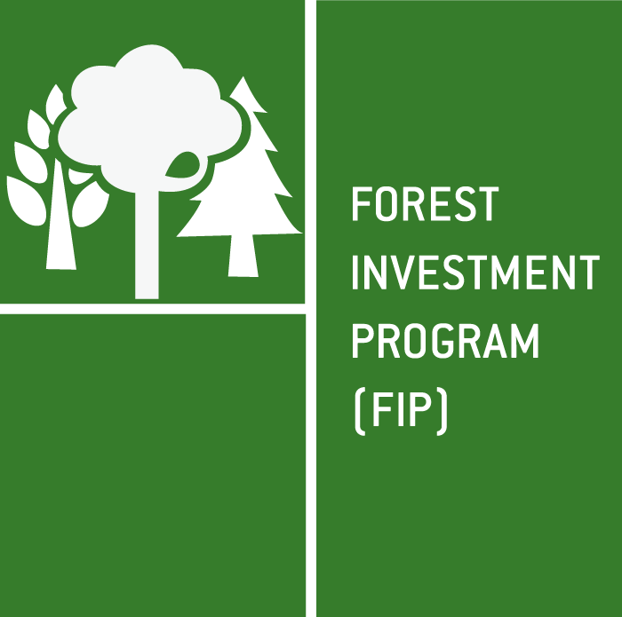
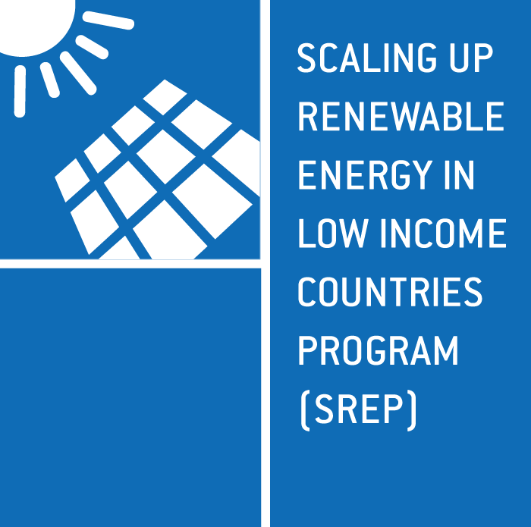
CLIMATE INVESTMENT FUNDS (CIF) $8.1 BILLION
$5.3
billion
$1.2
billion
$785
million
$796
million
Scaled-up demonstration, deployment, and transfer of low-carbon technologies in renewable energy, energy efficiency, and clean transport
Mainstream resilience in development planning and investments
Reduce emissions from deforestation and forest degradation, sustainably manage forests, and enhance forest carbon stocks
Demonstrate economic,
social, and environmental viability of renewable energy
in low income countries
Bangladesh
Bhutan
Bolivia
Cambodia
Ethiopia
Gambia
Honduras
Kyrgyz Republic
Madagascar
Malawi
Mozambique
Nepal
Niger
Philippines
Rwanda
Tajikistan
Uganda
Yemen
Zambia
Caribbean Region (Dominica,
Grenada, Haiti,
Jamaica,
St. Lucia,
St. Vincent and
the Grenadines)
Pacific Region
(Papua New Guinea,
Samoa, Tonga)
Bangladesh
Brazil
Burkina Faso
Cambodia
Cameroon
Congo Republic
Democratic Republic of Congo
Ecuador
Ghana
Guatemala
Guyana
Honduras
Indonesia
Ivory Coast
Lao People’s Democratic Republic
Mexico
Mozambique
Nepal
Peru
Rwanda
Tunisia
Uganda
Zambia
Chile
Colombia
Egypt
India
Indonesia
Kazakhstan
Mexico
Morocco
Nigeria
Philippines
South Africa
Thailand
Turkey
Ukraine
Vietnam
Middle East and North Africa Region
(Egypt, Jordan, Morocco, Tunisia)
Armenia
Bangladesh
Benin
Cambodia
Ghana
Haiti
Honduras
Kenya
Kiribati
Lesotho
Liberia
Madagascar
Malawi
Maldives
Mali
Mongolia
Nepal
Nicaragua
Rwanda
Sierra Leone
Tanzania
Uganda
Yemen
Zambia
Pacific Region (Solomon Islands, Vanuatu)
STRATEGIC CLIMATE FUND (SCF) $2.5 BILLION
Notes:
Established in 2008 to test, learn about and deploy climate finance at scale to advance clean technology and renewable energy; sustainable management of forests; and climate-resilient development.
Largest active multilateral climate finance vehicle worldwide: US$8.1 billion pledged from 14 donor countries, with estimated co-financing of US$57 billion (from MDBs and private sector)
Funds earmarked to implement nearly 300 projects and programs in 72 developing and middle-income countries.
Operates as partnership of contributor and recipient countries; observers from civil society, indigenous peoples and private sector, and other development partners
Implemented through 5 multilateral development banks (i.e., AfDB; ADB; EBRD; IDB; and WBG, incl. IFC).
CIF’s scale and flexible approach helps countries mitigate and adapt to climate change in an integrated fashion; it also reduces investment risk by bridging information and other gaps at country level to help crowd-in private investment.

Slide 4
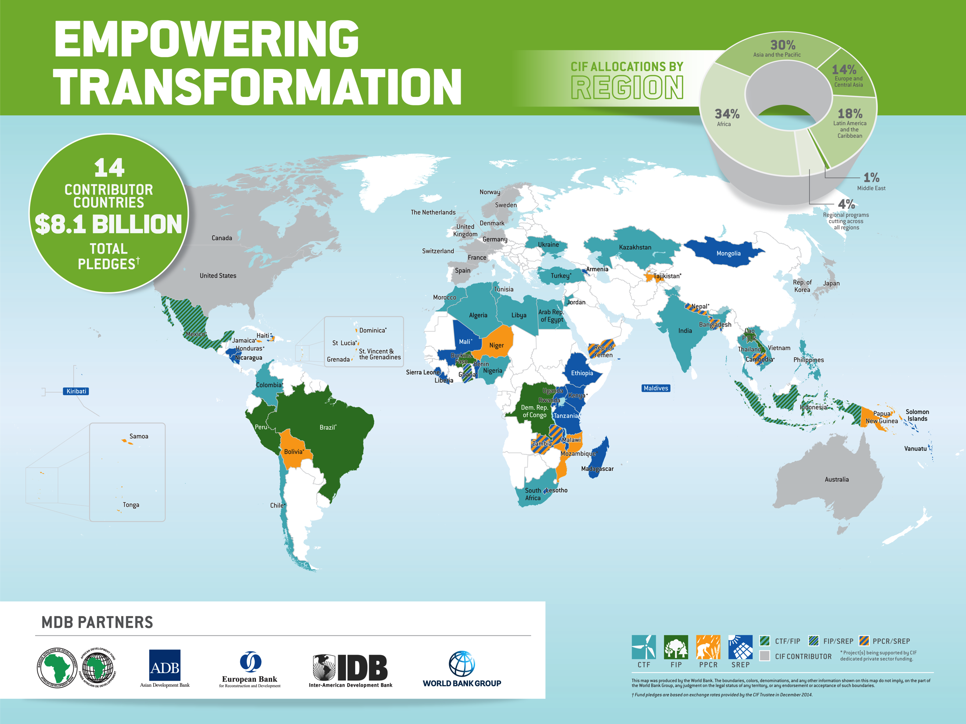

CIF financing spread

Slide 5
CIF Programmatic Approach
→ Two levels of design & implementation together forming a CIF country program: i.e., Investment Plan + Projects
Inter-MDB collaboration (MDBs offer: scale, convening power, & robust safeguard, procurement systems)
Country ownership of CIF programming process and results, embedding national goals/targets
Can move beyond project-by-project approach to programmatic approach with long-term, strategic arrangement of linked investment projects for national/ sector-wide transformation
Umbrella approach, maximizing synergies and co-financing opportunities
E.g., FIP: Looking across forest landscapes using integrated approach with range of stakeholders to address drivers of deforestation and forest degradation, within and outside the ‘forest’ sector, for triple win on poverty reduction + mitigation + resilience.
Notes:
Some characteristics of the programmatic approach:
Enhanced MDB collaboration at the country level (MDB mechanism chosen as they operate at scale and have convening power, along with robust safeguard, procurement and related systems)
Country-ownership for the CIF programming process and its results
Programmatic approach is introduced at the pilot country level through the joined planning process supported by the MDB partnership, and maintained throughout implementation of CIF operations
Key actors: country government, with MDBs
Able to move beyond project-by-project activities that have limited potential to effect national or sector-wide transformations, a programmatic approach entails a long-term, strategic arrangement of linked investment projects and activities aimed at achieving large-scale, systematic impacts and taking advantage of synergies and co-financing opportunities.
E.g., in FIP, looking across forest landscapes in an integrated, cross-sectoral manner and engaging with a broad base of stakeholders (with often conflicting views), the FIP is empowering countries to address the drivers of deforestation and forest degradation both inside and outside of the forest sector to achieve a triple win of poverty reduction, mitigation, and resilience.

Slide 6
CIF GENDER ACTION PLAN: FY15-FY16
CIF Gender Action Plan approved in June 2014
Background:
  CIF Gender Review (2013) and Strategic Environmental, Social and Gender Assessment (2010) concluded more efforts could be made to strengthen gender-responsive approaches in the CIF
  Sr. Gender Specialist recruited and in place February 2014
Approach: Plan seeks to mainstream gender in CIF policy & programming in support of gender equality goals via: (i) policy, (ii) program support, (iii) analytical work, (iv) monitoring & reporting, (v) knowledge & learning, (vi) additional MDB activities
Implementation: Joint effort of pilot countries, MDBs, and CIF AU
  Plan builds on existing MDB gender policies & safeguard measures, with: (i) closer monitoring of activities; (ii) generation of new knowledge; and (iii) enhancement of shared learning on gender in CIF

Slide 7
CIF Gender Action Plan FY15-FY16 – Approved June 2014
Aim: “To enhance gender-responsive outcomes across the CIF portfolio via knowledge generation, technical support and program learning”
Gender Action Plan implementation via:
  Applying mandated policies and procedures on gender across the CIF, and identifying where these may need to be strengthened;
  Providing technical support and capacity-building on gender for CIF investment plans and projects, on demand
  Generating new sector-specific knowledge and tools on gender for application to CIF programs (guidance sheets; toolkit support; analytical work on gender and energy)
→ Effort led by Sr. Gender Specialist, together with CIF Gender Working Group of MDB representatives in collaboration with pilot countries, and other stakeholders

Slide 8
CIF GENDER ACTION PLAN: FY15-16
 | Outputs | Lead
1. POLICY | CIF Gender Policy Review | CIF AU
2. PROGRAM SUPPORT | CIF program & sector guidance sheets Directory of gender experts Technical support to CIF IPs and projects, with MDBs | CIF AU
3. ANALYTICAL WORK | Gender and Renewable Energy Gender and REDD+: Tenure, Rights & Benefit-Sharing | CIF AU
4. MONITORING & REPORTING | Gender Portfolio Review and Scorecard Indicators Reporting on CIF gender program indicators annually; and gender reporting in 6-monthly operational & results reports | CIF AU
5. KNOWLEDGE & LEARNING | Gender and Resilience in the PPCR Gender, Mini-Grids and Employment Gender sessions in learning events (Pilot Countries meetings; Partnership Forum) | CIF AU
6. ADDITIONAL MDB ACTIVITIES | Gender and energy efficiency assessments (Turkey, Kazakhstan) with toolkits/ training Exploring gender co-benefits and revenue streams in PES/ REDD+ (incl. in forest-based value chains) | EBRD AfDB

Slide 9
Review of Plan Progress: Year One of Implementation
GENDER MAINSTREAMING APPROACH → (1) Aligning CIF gender policy and procedures; (2) Gender best practices (on sector content & mainstreaming process), and generation of new knowledge
→ Sector goals uppermost in mind: (e.g., expansion of RE markets; expanded energy access and household connectivity; more resilient adaptation planning at national level; sust. forest mngmt to increase carbon sinks).
Initial performance results strong
  60% of new projects approved since Plan adoption (i.e., July-Dec 2014) undertook sector-specific gender analysis at design stage, vs. baseline of 24%
  67% of new projects → specific activities targeting women, vs. baseline of 31%
  40% of new projects → gender-disaggregated indicators, vs. 25%
  At IP level, results even more encouraging…
Key achievements in FY15
  Support to New IPs and projects: May 2015 (Ghana, Haiti, and Nicaragua) – Gender integrated throughout policy analysis, assessment, project design, and M&E, with support from CIF AU.
  Gender policy and portfolio reviews, to establish CIF baselines; Gender in M&R and SARs
  Gender-specific learning sessions in Pilot Countries Meetings (SREP, FIP and PPCR) for sharing lessons
  Specific analytical work e.g., on gender and energy efficiency → into operations; toolkit and training
Externally in global climate finance sphere, joint learning and collaboration on gender mainstreaming and strategy among climate finance institutions, including GCF and GEF
Internal support to MDB gender strategy and mainstreaming processes by Sr. Gender Specialist, upon request (WBG Gender Strategy; EBRD Gender Strategy) → improved institutional emphasis on gender/CC

Slide 10
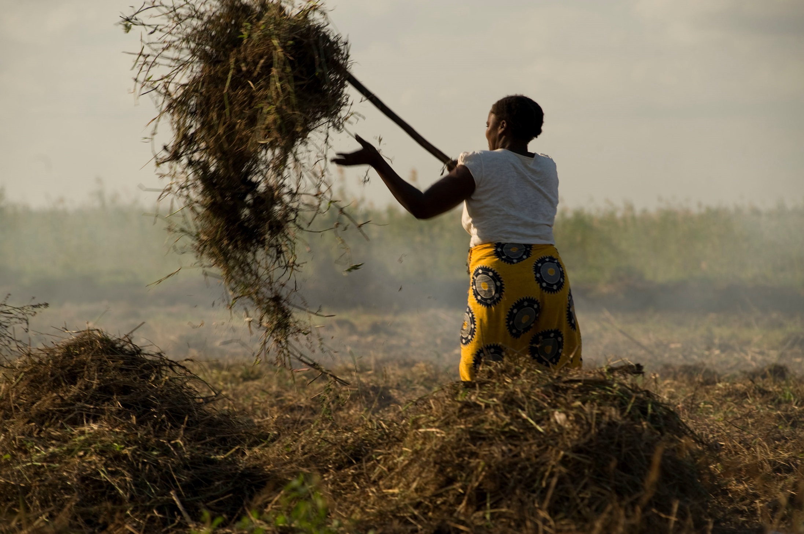
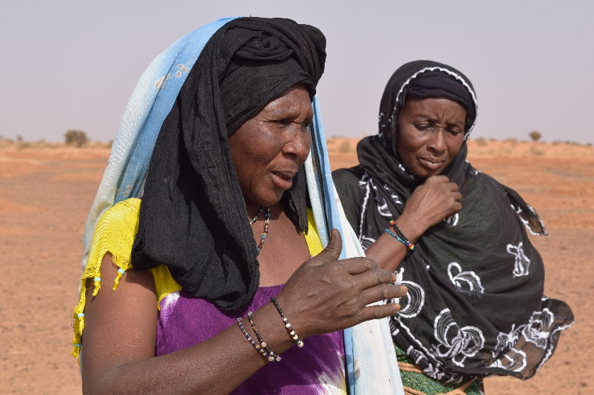
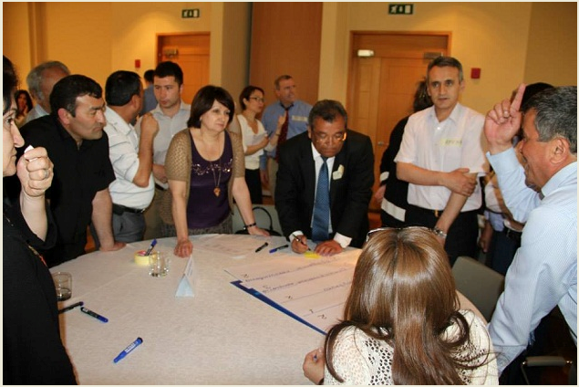
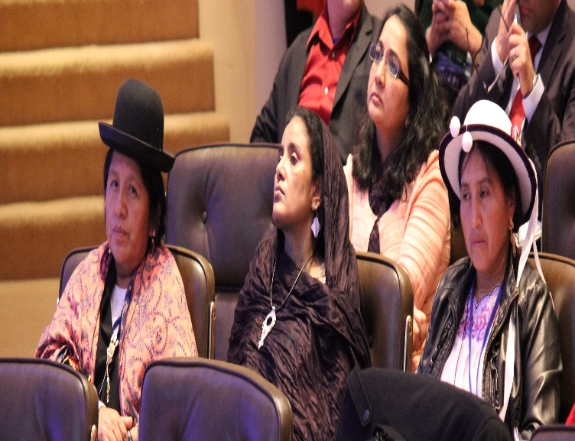
Key gender entry points within CIF
1. Governance and Accountability
4. Knowledge and Learning
2. Safeguards Processes
5. Technical Support
3. Monitoring and Reporting
6. Institutional reform
Notes:
The CIF has four-tiered approach to CSO engagement at the country level
Point 2: this includes monitoring and reporting.
Image is of national stakeholder consultation in Tajikistan to complete PPCR monitoring and reporting for 2014. Participants are working together to fill out scorecards on progress. Scorecards are a CIF innovation in M&R for climate finance built on the foundation of the programmatic approach.

Slide 11
CIF GENDER MAINSTREAMING APPROACH: Highlights
Key Elements within CIF GOVERNANCE AND OPERATIONS & attention to:
  (i) gender expertise on Investment Plan and project missions;
  (ii) gender analysis tied to sector and national strategy context
  (iii) improved beneficiary identification and targeting
  (iv) inclusion of women in CIF-related consultations in-country
  (v) gender-responsive monitoring and evaluation, including gender disaggregation
  (vi) gender-responsive design for CIF observer and other governance processes
CIF-required mandates (e.g., SREP design criteria on gender equity; or specific core indicator requirements on gender disaggregation) key in bolstering CIF outcomes on gender; technical support made available to teams
Upstream support to MDBs and countries on design of IPs and projects (e.g., gender review and technical assistance), on demand from MDBs.
Notes:
Examining benefits, risks and opportunities for women and poor communities from investments in large and small-scale RE; across diff. techs/ intervention types.
Best practice models, esp. on targeting, distribution and affordability; land acquisition/ resettlement; job creation and training; and potential performance-based incentives for firms.

Slide 12
Gender in CIF Program Design Documents
 | CTF | PPCR | FIP | SREP
INVESTMENT CRITERIA | ‘Development Impact’ only (though review cover sheets now have gender section) | (✓) | (✓) Co-benefit criteria around “gender equality” | ✓
RESULTS FRAMEWORKS | (✓) - gender-disaggregation, ‘if feasible’ (transport only at Core level); co-benefits… | ✓ Core and Co-benefit levels | ✓ Core and Co-benefit levels | ✓ Core and Co-benefit levels (‘Gender Impact’ indicator)
CONSULTATIONS | --- | ✓ Consultation with women’s groups and women | ✓ Consultation with women’s groups and women | ---
EXPERT GROUP | --- | ✓ Both gender expertise and gender balance | ✓ Both gender expertise and gender balance | ✓ Both gender expertise and gender balance
OVERALL | E.g., Gender specialist on Joint Missions for IP preparation; Projects follow MDB guidelines Gender balance and expertise among Expert Group members of FIP, PPCR, SREP programs; and observer groups Gender in independent technical review of Investment Plans (PPCR; FIP; SREP)
Notes:
The four CIF programs (i.e., CTF, PPCR, FIP and SREP) have not been uniformly designed with regard to social and gender inclusion. This is in part due to sectoral considerations, but largely due to the evolution of the Climate Investment Funds themselves since their establishment (CIF Gender Review 2013). Thus at the level of specific design principles of certain CIF programs, there is policy language that speaks directly to issues of gender and social inclusion.
For example, SREP design principles state that the program should “seek wider economic, social and environmental co-benefits, [including] enterprise creation, and increased social capital, particularly greater involvement and empowerment of women and other vulnerable groups” (cited in CIF 2010: 29). The SREP design principles go on to mandate: (a) full and effective participation through existing mechanisms for collaboration and consultation; and (b) that projects should demonstrate economic, social and environmental benefits.
FIP design documents, including for the Dedicated Grant Mechanism, also provide for women’s participation in consultations, a dedicated ‘Social Development and Gender Specialist’ within the expert group, and for identification of co-benefits of proposed projects for women beneficiaries in results frameworks. PPCR programs, as national planning and coordination umbrella frameworks for adaptation investments, promote linkages to women’s ministries, consultation with women’s organizations, and use of gender-disaggregated indicators. PPCR joint mission guidelines and FIP investment criteria also require consultation with women during joint missions. CTF design documents, however, focus more on the energy systems themselves, and overall contributions from CTF investments to GHG emissions reduction goals, in contrast to reporting on the social and/or gender impacts of the technology.

Slide 13
Gender Scorecard Indicators for CIF Investment Plans
 | Sector-specific Gender Analysis (%) |  | Women-Specific Activities (%) |  | Gender-disaggregated Indicators (%)
 | Since Inception | Jul 1- Dec 31, 2014 | Since Inception | Jul 1- Dec 31, 2014 | Since inception | Jul 1- Dec 31, 2014
CTF | 6 | n.a. | 13 | n.a. | 13 | n.a.
PPCR | 65 | n.a. | 70 | n.a. | 20 | n.a.
FIP | 50 | n.a. | 13 | n.a. | 75 | n.a.
SREP | 64 | 100 | 45 | 0 | 72 | 100
Overall | 45 | 100 | 40 | 0 | 36 | 100
Notes:
SMALL N – Projects
Overall, specific gender efforts to date have been more prevalent among the SREP and PPCR programs, than in FIP and CTF.
Note, however, that in looking specifically at the category of women-targeted activities, PPCR IPs and projects edge out SREP, suggesting a good deal of gender content among PPCR programming.
Since inception, SREP IPs and projects led in gender-responsiveness as measured by the three key gender indicators.
FIP was the next highest performer after SREP and PPCR: CTF was a distant fourth (in all sub-categories but gender analysis in projects… where it trailed other programs by less of a margin.
In sum, gender performance across the CIF is improving with time, and is most responsive to CIF program requirements, such as investment criteria and gender-disaggregated Core Indicator mandates, where these exist.
OTHER FACTORS: COUNTRY STRATEGIES/ POLICY; MDB’S OWN REQUIREMENTS

Slide 14
Gender Scorecard Indicators for CIF Projects
 | Sector-specific Gender Analysis (%) |  | Women-Specific Activities (%) |  | Gender-disaggregated Indicators (%)
 | Since inception | Jul 1- Dec 31, 2014 | Since inception | Jul 1- Dec 31, 2014 | Since inception | Jul 1- Dec 31, 2014
CTF | 22 | 50 | 18 | 50 | 16 | 13
PPCR | 30 | 67 | 53 | 100 | 23 | 67
FIP | 29 | 100 | 53 | 100 | 35 | 100
SREP | 47 | 67 | 40 | 67 | 80 | 67
Overall | 28 | 60 | 35 | 67 | 26 | 40
Notes:
SMALL N – Projects
Overall, specific gender efforts to date have been more prevalent among the SREP and PPCR programs, than in FIP and CTF.
Note, however, that in looking specifically at the category of women-targeted activities, PPCR IPs and projects edge out SREP, suggesting a good deal of gender content among PPCR programming.
Since inception, SREP IPs and projects led in gender-responsiveness as measured by the three key gender indicators.
FIP was the next highest performer after SREP and PPCR: CTF was a distant fourth (in all sub-categories but gender analysis in projects… where it trailed other programs by less of a margin.
In sum, gender performance across the CIF is improving with time, and is most responsive to CIF program requirements, such as investment criteria and gender-disaggregated Core Indicator mandates, where these exist.
OTHER FACTORS: COUNTRY STRATEGIES/ POLICY; MDB’S OWN REQUIREMENTS

Slide 15



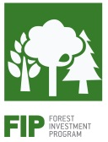
Gender and social considerations in CIF programs
CIF advances gender and social considerations in its mitigation and adaptation programs through such design features as:
use of co-benefit indicators for all programs
explicit poverty and gender criteria, esp. among newer programs, re investment selection
support to national & local climate planning institutions, incl. use of gender focal points
funding windows such as Dedicated Grant Mechanism for Indigenous Peoples and Local Communities (FIP program)
Forest users & producers within landscape-based approach; Benefit-sharing & participation of women in local forest governance; tenure security; forest-based livelihoods
Large-scale projects in RE EE; Transport; identifying distributional impacts, to move beyond safeguards approaches alone
Significant focus on portfolio investments with local impact, incl. off-grid investments & RE sector small enterprises
Community-level impacts & institutional development at all levels central to PPCR program approach
Notes:
Requires examination of:
-Stated goals and objectives (logic of impacts; how beneficiaries are envisioned);
-Project technology choices;
Employment impacts;
Access to services (and steps taken to reduce barriers; extension/ hydromet to reach all users of agric. and weather info);
Project governance and monitoring (stakeholder engagement);
Safeguards implementation, incl. livelihoods and resettlement.

Slide 16
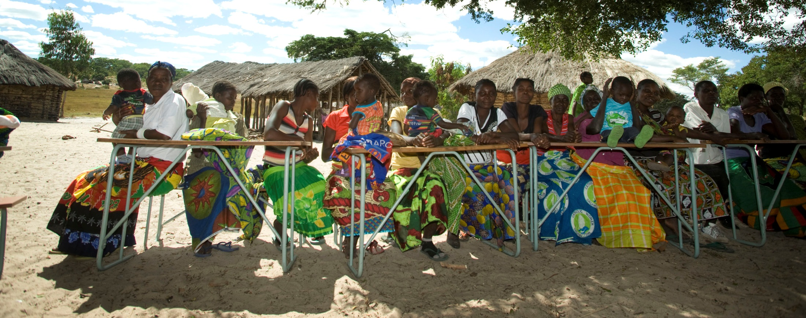
Zambia PPCR: “Strengthening Climate Resilience and the Barotse Sub-Basin”
* Design Features: TARGETING WOMEN; CUSTOMIZED SUPPORT; GENDER IN GRANT INVESTMENT CRITERIA/ USE OF QUOTAS
USD 36m project (IBRD): Strengthens Zambia’s national institutional structure for climate resilience and improves adaptive capacity of vulnerable communities in Barotse sub-basin. Targets 25,800 households in 8 districts, including FHHs.
Includes focus on climate information services, and reserves at least 30% of individual ‘champion grants’ for women for local adaptation activities.
Notes:
IBRD: Strengthening Climate Resilience in Zambia and the Barotse Sub-Basin (Zambia) : Zambia's climate is highly variable, with frequent droughts, seasonal and flash floods, extreme temperatures and dry spells. Floods and droughts have increased in frequency over the past three decades, costing the nation an estimated 0.4% in annual economic growth. This project is supporting strengthening of Zambia's institutional framework for climate resilience and improving of the adaptive capacity of vulnerable communities in the Barotse sub-basin. Three components: (a) Strategic National Program Support, aiming to strengthen the national institutional and financial framework for climate resilience; (b) Support to Participatory Adaptation, through strengthening of the adaptive capacity of vulnerable rural communities in the Barotse sub-basin; (c) Pilot Participatory Adaptation, through the funding of actual participatory adaptation investments in the Barotse sub-basin, including community adaptation sub-grants.
Direct project beneficiaries under Participatory Adaptation is approximately 130,000 (about 25,800 households) in 24 targeted wards (sub-districts) and 8 target districts. At the community level, the project will target an estimated 32 percent of female-headed households. The project will also reserve at least 30 percent of individual champion grants for women.

Slide 17
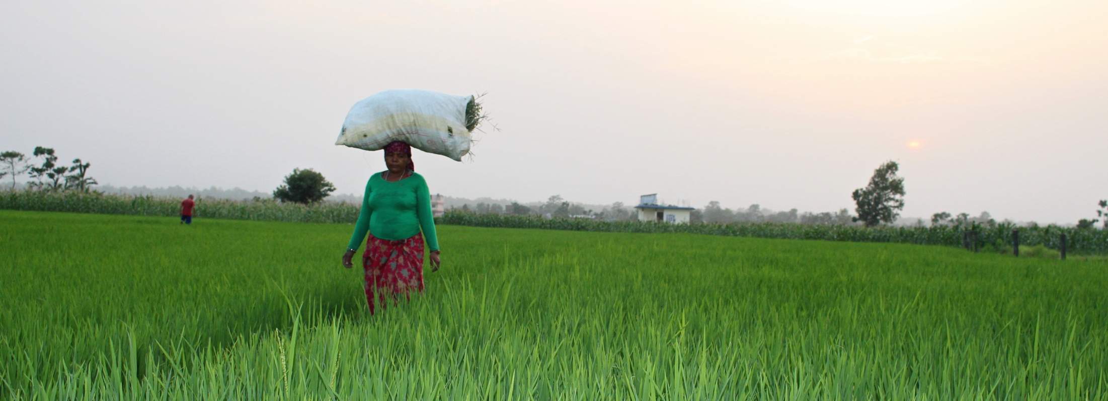
Nepal PPCR: “Building Climate Resilience of Watersheds in Mountain Eco-Systems”
*Design Feature: WOMEN’S PARTICIPATION IN GOVERNANCE AND LOCAL RESOURCE MANAGEMENT
USD 24m project (ADB): Improving watershed planning in climate-vulnerable areas and community-based WRM for irrigation and domestic uses. Benefits 35,000 households, with enhanced water productivity through improved agricultural practices.
Targeted goals for women’s participation in water committees, including by Dalit women → Equity in local water allocation arrangements, micro-irrigation considerations benefiting women

Slide 18
Advancing gender equality outcomes through CIF investments
Good practice examples from portfolio range from:
  Targets for women’s employment-related outcomes from projects, both direct and indirect (CTF)
  Training delivered to women in different sectors (various projects);
  Ancillary services such as credit schemes (various projects);
  Gender focal points posted in adaptation planning units of countries (PPCR Yemen);
  Women’s participation as primary beneficiaries in climate-responsive social protection in soil and water mngmt (Niger PPCR project);
  Identifying and tracking of female beneficiary targets (incl. those in additional vulnerable category of national
  Gender-sensitive project design for mass rapid transit in urban areas (CTF Vietnam project)
  Women’s participation in user association membership and leadership in water sector (PPCR Tajikistan project)
  Women-owned enterprise development in cookstove retailing (SREP Nicaragua IP; planned project); ethnic minority groups as part of national goals on social inclusion in RE (SREP Nepal project);
  Enhancing women’s role in local governance and planning on forest resources (FIP Mexico project on ejidos).
→ Projects largely advancing strategic gender interests, incl. from an economic, or voice/ agency viewpoint i.e., expanded participation in public sphere) – Positive Externalities for inclusive governance
→ Some simply making project management or organizational changes to improve program/ project responsiveness on gender (e.g., through focal point posting or tracking of beneficiaries).

Slide 19
Gender-Responsive Design: Country Examples
CTF: Vietnam “Sustainable Urban Transport for HCMC Mass Rapid Transit Line 2”
  Increasing women’s access to transport services, and to employment in the transport sector
  Targets of 20% of project construction jobs and 30% of station jobs for women
  Project stations feature: (i) dedicated waiting spaces on platforms for women; (ii) shop spaces for female-owned businesses; (iii) women-only carriages with child seating; (iv) secure street lighting and security cameras at stations; (v) multi-modal planning and ticket/ schedules systems to suit multiple destinations used by women; and (vi) direct marketing to women as metro users.
PPCR: Tajikistan “Pyanj River Basin” Project - good practices in gender mainstreaming,
  e.g., multi-stakeholder planning (with participation by women’s associations); linkages to the national women’s machinery; gender-sensitive social mobilization and institutional development in land and water management for multiple-use; and clear gender targets in employment, training, and governance
  Project reaches 35,000 households. Improved water storage infrastructure in this climate-vulnerable basin has reduced time spent on water collection by women by 75%.
SREP: Maldives “Preparing Outer Islands for Sustainable Energy Development Program”
Gender-specific targets with at least 25% of energy parastatal staff trained being female;
Gender-inclusive community outreach program targeting women’s development committees and women consumers in the outer islands to improve household level demand-side management;
Reduced off-peak and/or shoulder rate tariffs for women-owned micro and small enterprises.
FIP: Mexico “Forests and Climate Change” Project: (i) mainstreaming gender in National Forestry Commission (CONAFOR) planning, budgeting, and monitoring processes; (ii) work with women forests and women forest producers to share experience, expand training and research, and enhance women’s role in formal forest governance in ejidos, incl. non-timber forest production and management

Slide 20
Specific Focus Areas for FY16
Advancing CIF Gender Policy, following policy review and discussions
Scaling-up of gender technical support to individual Investment Plan and project preparation
New tools, including sector- and program-specific guidance sheets to teams
Analytical study on gender and renewable energy, with focus on large-scale renewable energy projects, particularly to help support the CTF program
Strengthening of gender-responsive M&E
Region-specific learning events to enhanced skills and country capacity on gender mainstreaming in particular CIF sectors

Slide 21
Recommendations for GCF and other Climate Finance Institutions
Consider how ‘best’ to:
[CIVIL SOCIETY]: Use women’s membership organizations & local gender CSO networks to enhance discussions on project ‘realism’ and gender-responsive design.
[GOVERNMENT]: Engage with (gender) focal points of NDAs & IEs.
[CONSULTATIONS]: Enhance consultation processes, including with rural and urban women, and women’s organizations (w/ budget, time for fund staff CB on process).
[NATIONAL GOALS]: Ensure investments contribute to national goals and targets on gender equality, while offering new models for sector intervention types.
[M&R]: Mainstream gender good practice approaches to M&R (esp. of core indicators); and for GCF, consider how sector-wide/ programmatic outcomes might be framed (esp. on gender impacts).

Slide 22
Recommendations (cont’d)
Consider how ‘best’ to:
[GLOBAL ALLIES]: Leverage specific global support on gender from various ‘sectors’ (e.g., donors; global CSOs; peer funds) for enhanced program learning & expanded reach.
[EMPOWERMENT]: Both routinize gender support and mainstreaming in terms of process and outreach, while considering use of pilot ‘thrust’ projects/ programs for more innovative approaches to women’s empowerment, including economic and political empowerment, in an institutional sense.
[STAFF CAPACITY]: Approach capacity-building and awareness-raising among fund staff on gender mainstreaming and analysis.
[OBSERVERS]: Design ‘observer’ function (what types of groups, e.g., one focused solely on gender?; how much power granted in the Fund’s Board’ governance context).
[LEARNING AND EVALUATION]: Design a gender-responsive integrated fund ‘learning and evaluation’ function from the start.

Slide 23




Thank You!
Email akuriakose@worldbank.org
Twitter @ATKuriakose
www.climateinvestmentfunds.org
@CIF_Action
https://www.youtube.com/user/CIFaction
https://www.flickr.com/photos/cifaction/sets

