Slide 1
SREP Semi-Annual Operational Report
^{DATE June 17, 2016}
^{PLACE Oaxaca,} ^{Mexico}
VENUE SREP Sub-Committee Meeting

Slide 2
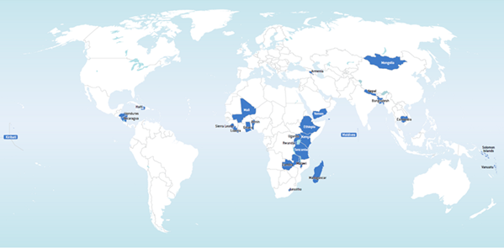
SREP Countries
Africa
Benin
Ethiopia
Ghana
Kenya
Lesotho
Liberia
Madagascar
Malawi
Mali
Rwanda
Sierra Leone
Tanzania
Uganda
Zambia
Asia Pacific
Bangladesh
Cambodia
Kiribati
Maldives
Mongolia
Nepal
Solomon Islands
Vanuatu
ECA/LAC/MENA
Armenia
Haiti
Honduras
Nicaragua
Yemen

Slide 3
SREP Overview
Endorsements: 18 investment plans and 7 PSSA concepts
Funding approvals: $226 million for 21 projects
Expected results: 1.67 GW new RE capacity; 6,502 GWh electricity generated annually; new or improved access to 16.8 million people
 | Indicative Allocation |  |  | Approved |  | Disbursement
 | TOTAL | IP | PSSA | Sub-Committee | MDB
SREP funding (in $M) | 808.6 | 716.2 | 92.4 | 225.8 | 193.75 | 26.9
Number of projects | 66 | 59 | 7 | 21 | 19 | 11

Slide 4
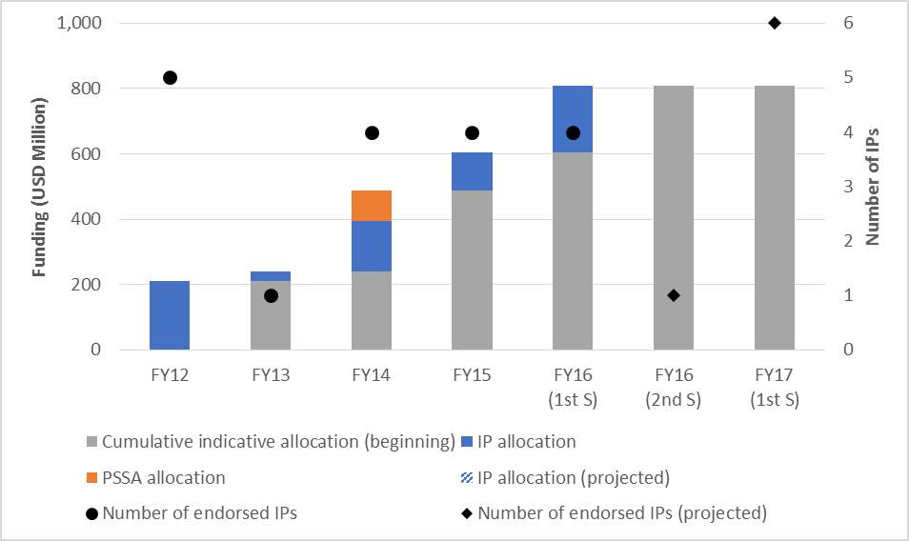
Investment Plans
Total endorsed: 18 (4 in November 2015)
June 2016: Cambodia
FY17: Benin, Lesotho, Madagascar, Malawi, Sierra Leone, and Zambia
Remaining: Kiribati and Yemen

Slide 5
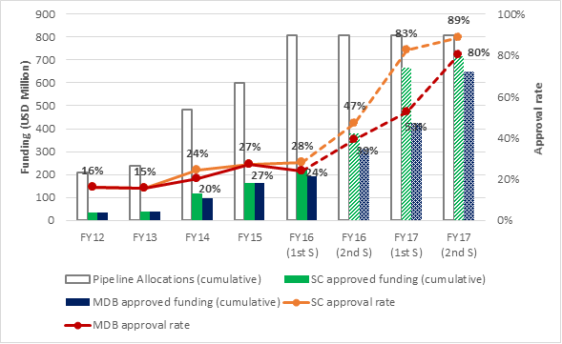
Funding Approval by SC
Total: $226 million ($53 million for 4 projects during July-Dec 15)
Projected submissions: 14 projects during Jan-June 16; 31 projects during FY17
Addendum to update submission schedule for Jan-May 16

Slide 6
Resource Availability
Addendum to update resource availability schedule and project approvals as of May 31
Available resources (current + reserves + expected):
434.5+ 52.9+2.4 = $489.8 million
Projected investment income – admin cost = -$20.1 million
Net available resources: 489.8-20.1 = $469.7 million
Remaining pipeline: $533.5 million
Current over-programming: $63.9 million

Slide 7
Potential Headroom for Over-Programming
Net available resources: $469.7 million
Headroom for over-programming: 469.7x0.3 = $140.9 million
Current over-programming: $63.9 million
Headroom in the pipeline: $77.0 million
Cambodia investment plan: $30 million
Remaining headroom: $47 million

Slide 8
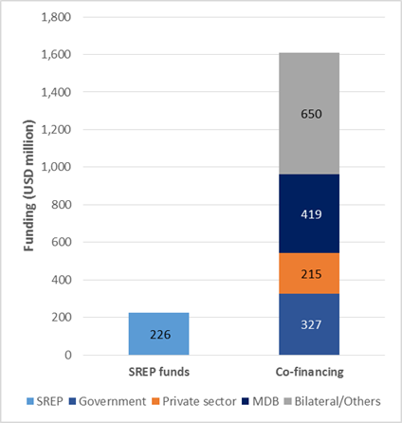
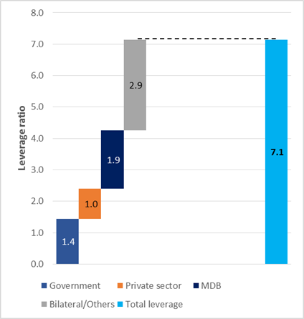
Sources of Co-financing
Every SREP dollar leverages more than $7 from other sources.

Slide 9
Portfolio Analysis
SREP Portfolio by region
SREP Portfolio by public-private sector

Slide 10
Portfolio Analysis by Technology

Slide 11
Knowledge and Gender
Knowledge Management
Gender Assessment of SREP Projects, Jan-Dec 15
Clean Energy Mini-grids: In collaboration with ESMAP, organize three regional dialogues/study tours in 2016-17; first one took place in Kenya in May 2016
Multi-tier Access Framework: In partnership with ESMAP, select 10 SREP countries to implement MTF surveys, analysis, and capacity building in 2016-17
Sector-specific gender analysis: 100%
Gender-disaggregated indicators: 75%
Women-specific activities: 88%
SREP has performed very well due to explicit requirements on gender-sensitive reporting.

Slide 12
Zhihong Zhang, Ph.D. Senior Program Coordinator CTF and SREP zzhang2@worldbank.org (202) 473-9852
www.climateinvestmentfunds.org
@CIF_Action https://www.youtube.com/user/CIFaction https://www.flickr.com/photos/cifaction/sets

