Slide 1

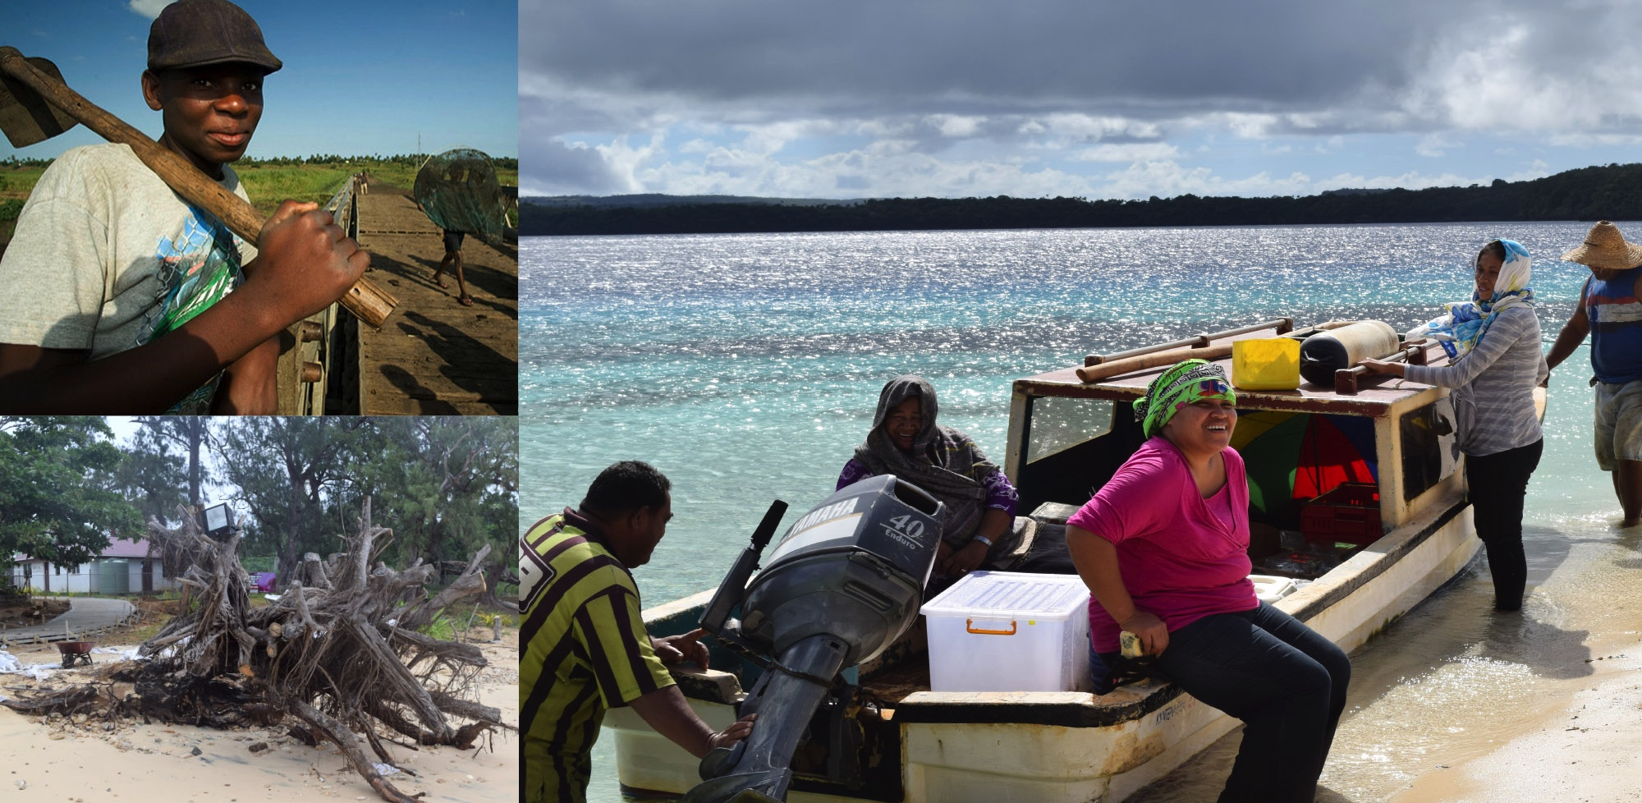
The Pilot Program for Climate Resilience (PPCR)
Notes:
Thank you Madame Chair. Good Morning Everyone.

Slide 2
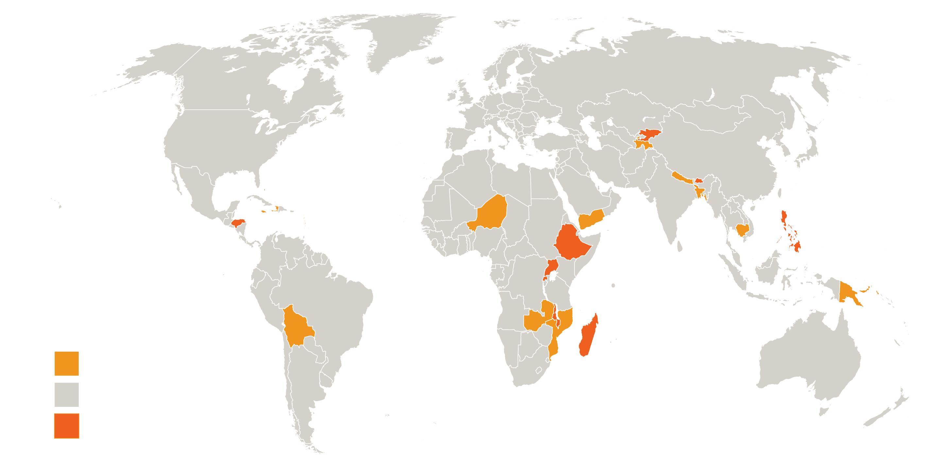
PPCR Countries
PPCR countries
Other
New pilot countries
Notes:
Key words:
Strengthening
Enhancement
Building Capacity

Slide 3
New Country Updates
Country | MDBs | Dialogue | Scoping Mission | Joint Mission | IPPG Request | Notes
Bhutan | IBRD (lead), ADB, IFC |  |  |  | 
Ethiopia | IBRD, AfDB, IFC |  |  |  | 
Gambia | IBRD, AfDB |  | 
Honduras | IDB, IBRD, IFC |  |  |  |  | Joint PPCR/FIP scoping mission
Kyrgyz Republic | EBRD (lead), IBRD |  |  |  | 
Madagascar | IBRD, AfDB |  |  |  | 
Malawi | IBRD, AfDB |  | 
Philippines | IBRD |  |  |  | 
Rwanda | AfDB, IBRD |  |  |  |  | Joint PPCR/FIP scoping mission
Uganda | AfDB, IBRD |  |  |  |  | Joint PPCR/FIP scoping mission
Notes:
Shaded cells indicate new pilot countries
Why are the old countries in there?

Slide 4
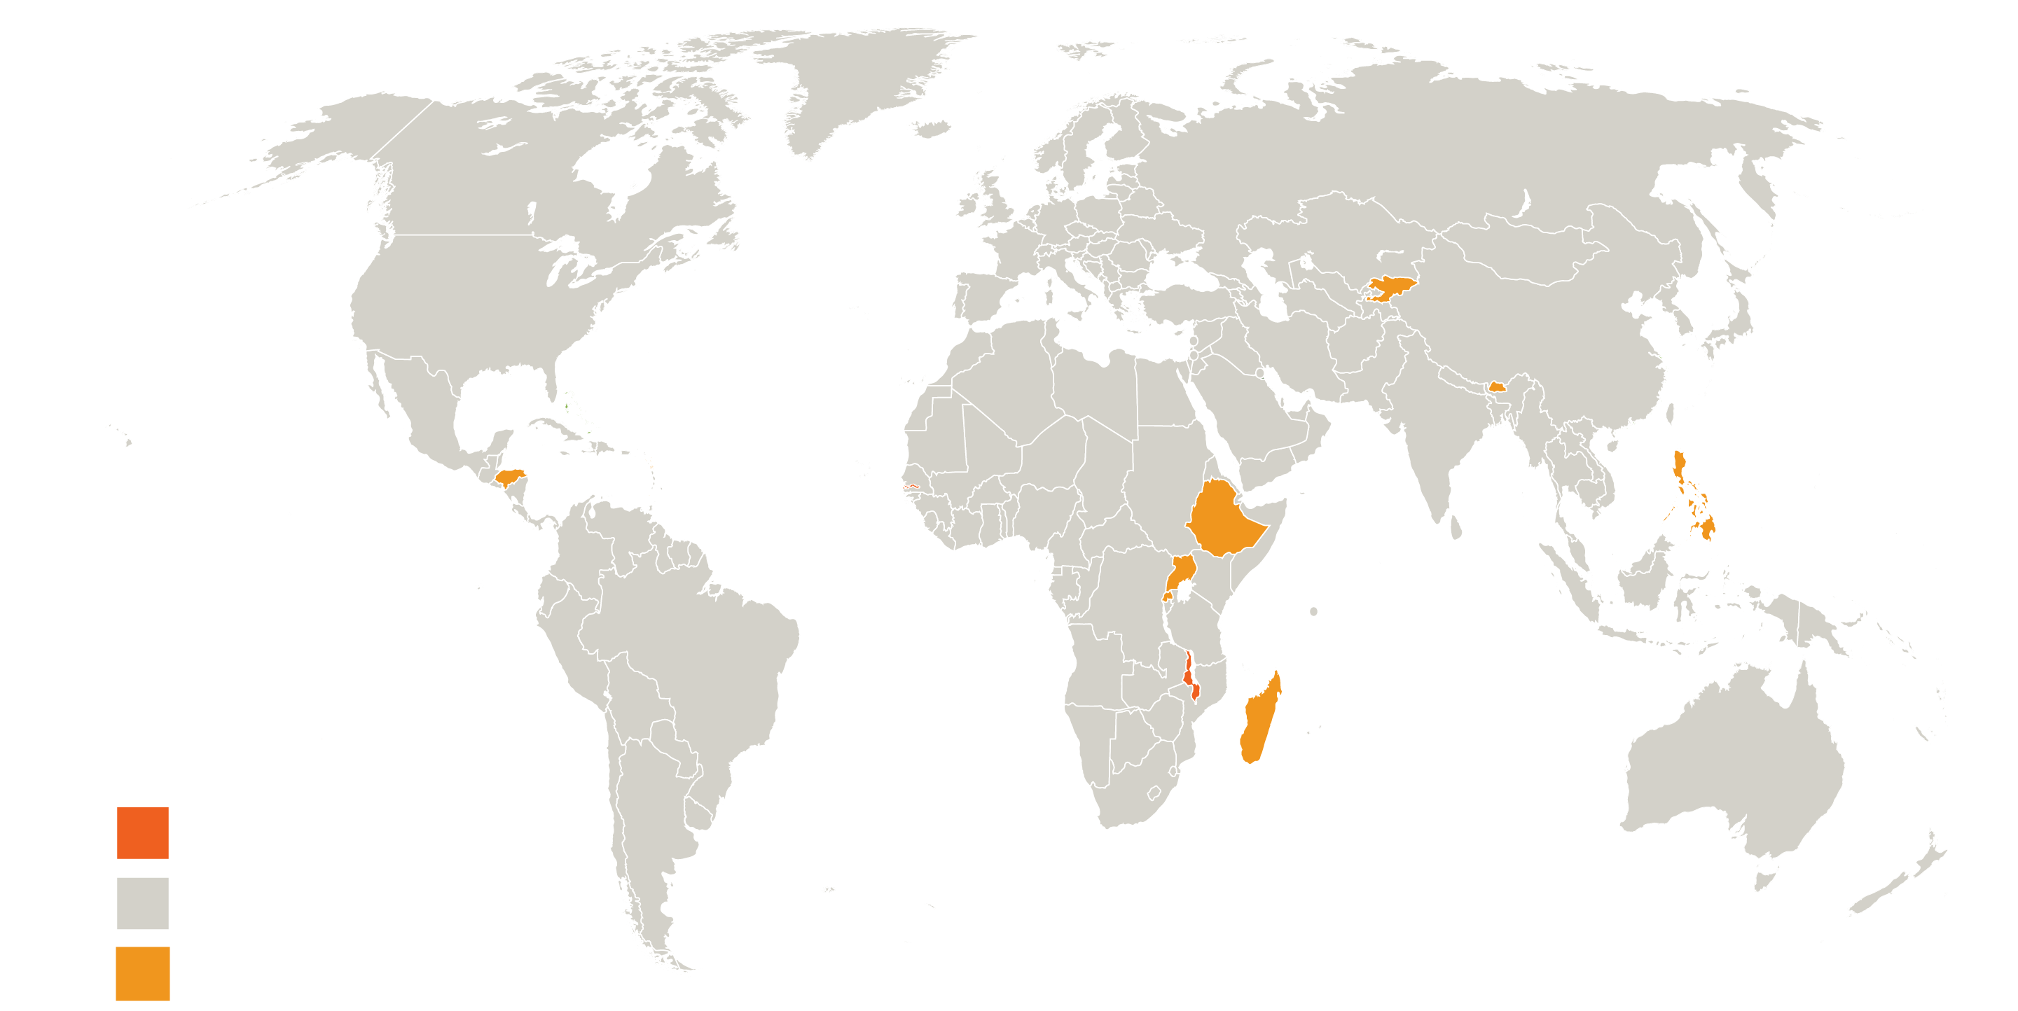
New Pilot Country Updates: IPPG requests
Bhutan
IBRD
Ethiopia
IBRD
Philippines
IBRD
Honduras
IBRD
Gambia
AfDB
Uganda
AfDB
Rwanda
IBRD
Malawi
IBRD
Madagascar
IBRD
IPPG request not yet submitted
Other
IPPG request submitted
Notes:
2 countries have not yet submitted IPPGS requests: Gambia, Malawi
MDBs names below countries also

Slide 5
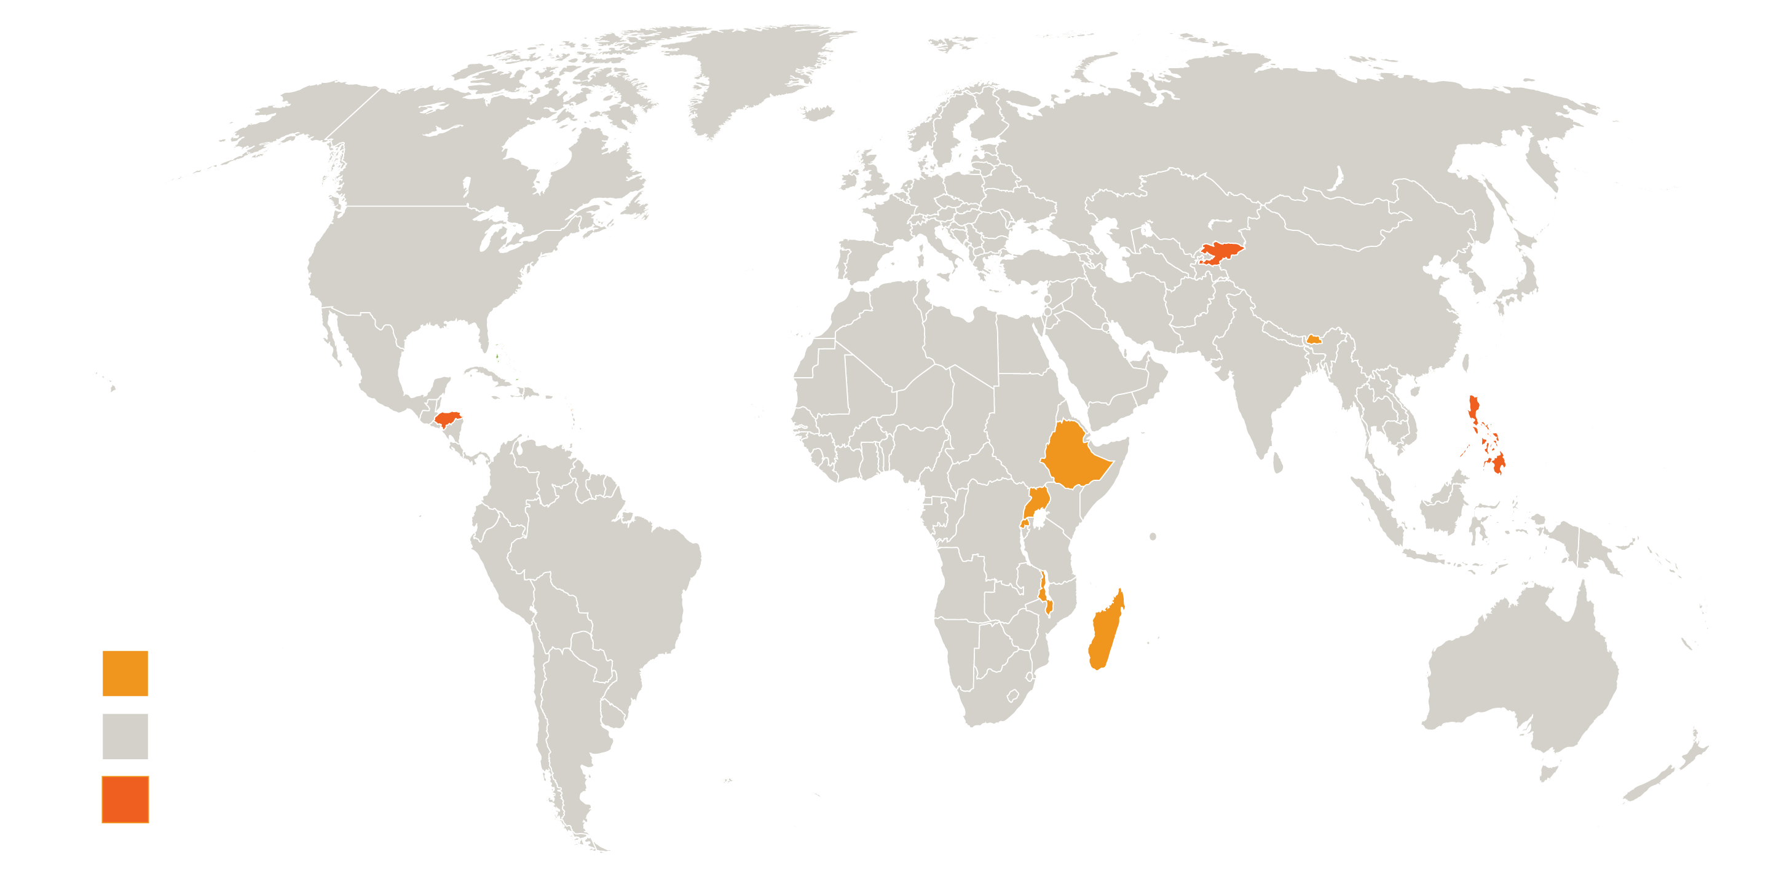
New pilot country updates:
Joint and Scoping Missions
Kyrgyz Republic
Joint Mission:
April 2016
Philippines
Joint Mission: April 2016
Honduras
Joint Mission: March 2016
Scoping Mission completed, planning Joint Mission
Other
Joint Mission completed

Slide 6
Disbursing Projects
Building Capacity for Climate Resilience
Improvement of Weather, Climate, and Hydrological Delivery project
Environmental Land Management and Rural Livelihoods Project
Building Climate Resilience in the Pyanj River Basin Project
Enhancement of Flood and Drought Management in Pursat Province
Climate Proofing of Agricultural Infrastructure and Business-focused Adaptation
Provincial Roads Improvement Project - Climate Proofing of Roads in Prey Veng, Svay Rieng, Kampong Chhnang and Kampong Speu Provinces
GMS Southern Economic Corridor Towns Development Project
Mainstreaming Climate Resilience into Development Planning
Disaster Vulnerability Reduction Project (St Lucia)
Investment Plan for the Caribbean Regional Track (Caribbean Region)
Enhancing Climate Resilience for West Coast Road Project
Enhancing the Climate Resilience of Coastal Resources and Communities (Samoa)
Disaster Vulnerability Reduction Project (DVRP) (Dominica)
Building Climate Resilience of Watersheds in Mountain Eco-Regions
Building Resilience to Climate-Related Hazards
Mainstreaming Climate Change Risk Management in Development
Disaster Vulnerability and Climate Risk Reduction (SVG)
Disaster Vulnerability and Climate Risk Reduction Project (Grenada)
Adaptation Program and Financing Mechanism for the Pilot Program For Climate Resilience Jamaica
Centre Artibonite Regional Development Project (Haiti)
Climate Information Development and Forecasting Project (PDIPC)
Water Resources Mobilization and Development Project (PROMOVARE)
Community Action Project for Climate Resilience (CAPCR)
Coastal Embankment Improvement Project Phase I (CEIP-I)
Coastal Towns Infrastructure Improvement Project
Coastal Climate Resilient Infrastructure Project
Climate Change Capacity Building and Knowledge Management
Climate Information System and PPCR Program Coordination
Climate Resilience - Integrated Basin Management Project
PPCR countries
Other
New pilot countries
Strengthening Climate Resilience (PPCR Phase II) Project
Strengthening Climate Resilience in the Kafue Sub-Basin
Climate Resilience Sector Project (Tonga)
Roads & Bridges Management and Maintenance Project - APL2
Climate Resilience: Transforming Hydro-Meteorological Services
Sustainable Land & Water Resources Management Project (SLWRMP)
Baixo Limpopo Irrigation and Climate Resilience
Implementation of the Strategic Program for Climate Resilience (SPCR): Pacific Region
Notes:
Key words:
Strengthening
Enhancement
Building Capacity

Slide 7
Disbursing countries, in USD M
$1.2m
(Caribbean Region)
$1.1m (Dominica)
$11.4m
$1.3m
(St Lucia)
$21.2m
$7.2m (Grenada)
$16.6m
$9.4m
$3.2m (SVG)
$3.5 (Samoa)
$0.8m (Jamaica)
$3.1m
$1m (Haiti)
$28.6m
$1.2m
$12.5m
$4.1m
$1.6m
(South Pacific Region)
PPCR countries
Other
New pilot countries
$1.1m
(Tonga)
$10.1 m
Notes:
1.5TA for new pilot countries except Gambia and Malawi

Slide 8
Trends in Disbursements
Cumulative disbursements: USD 146.3 million
16% of PPCR portfolio
Disbursed in reporting period: USD 40.1 million

Slide 9
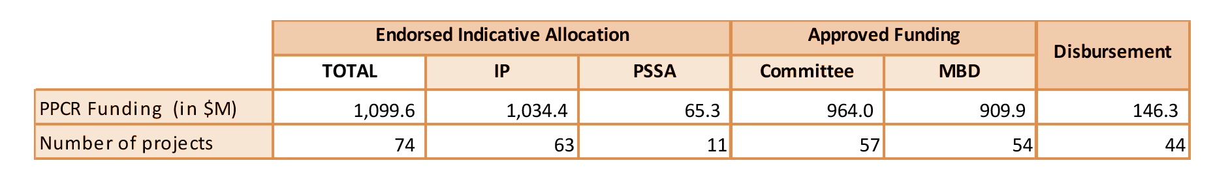
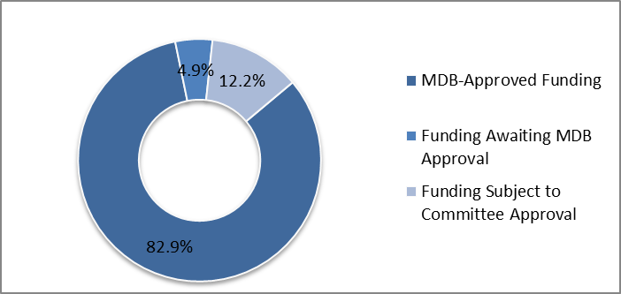
Summary: PPCR Portfolio Overview
(As of December 31, 2015)
SPCR Project Funding Approval Status (as of December 2015)
Notes:
74 projects. Entire portfolio of which 63 projects and 11 PSSA. Of this 57 projects have been approved and 54 MDB Board approval. 44 projects have been disbursing.

Slide 10
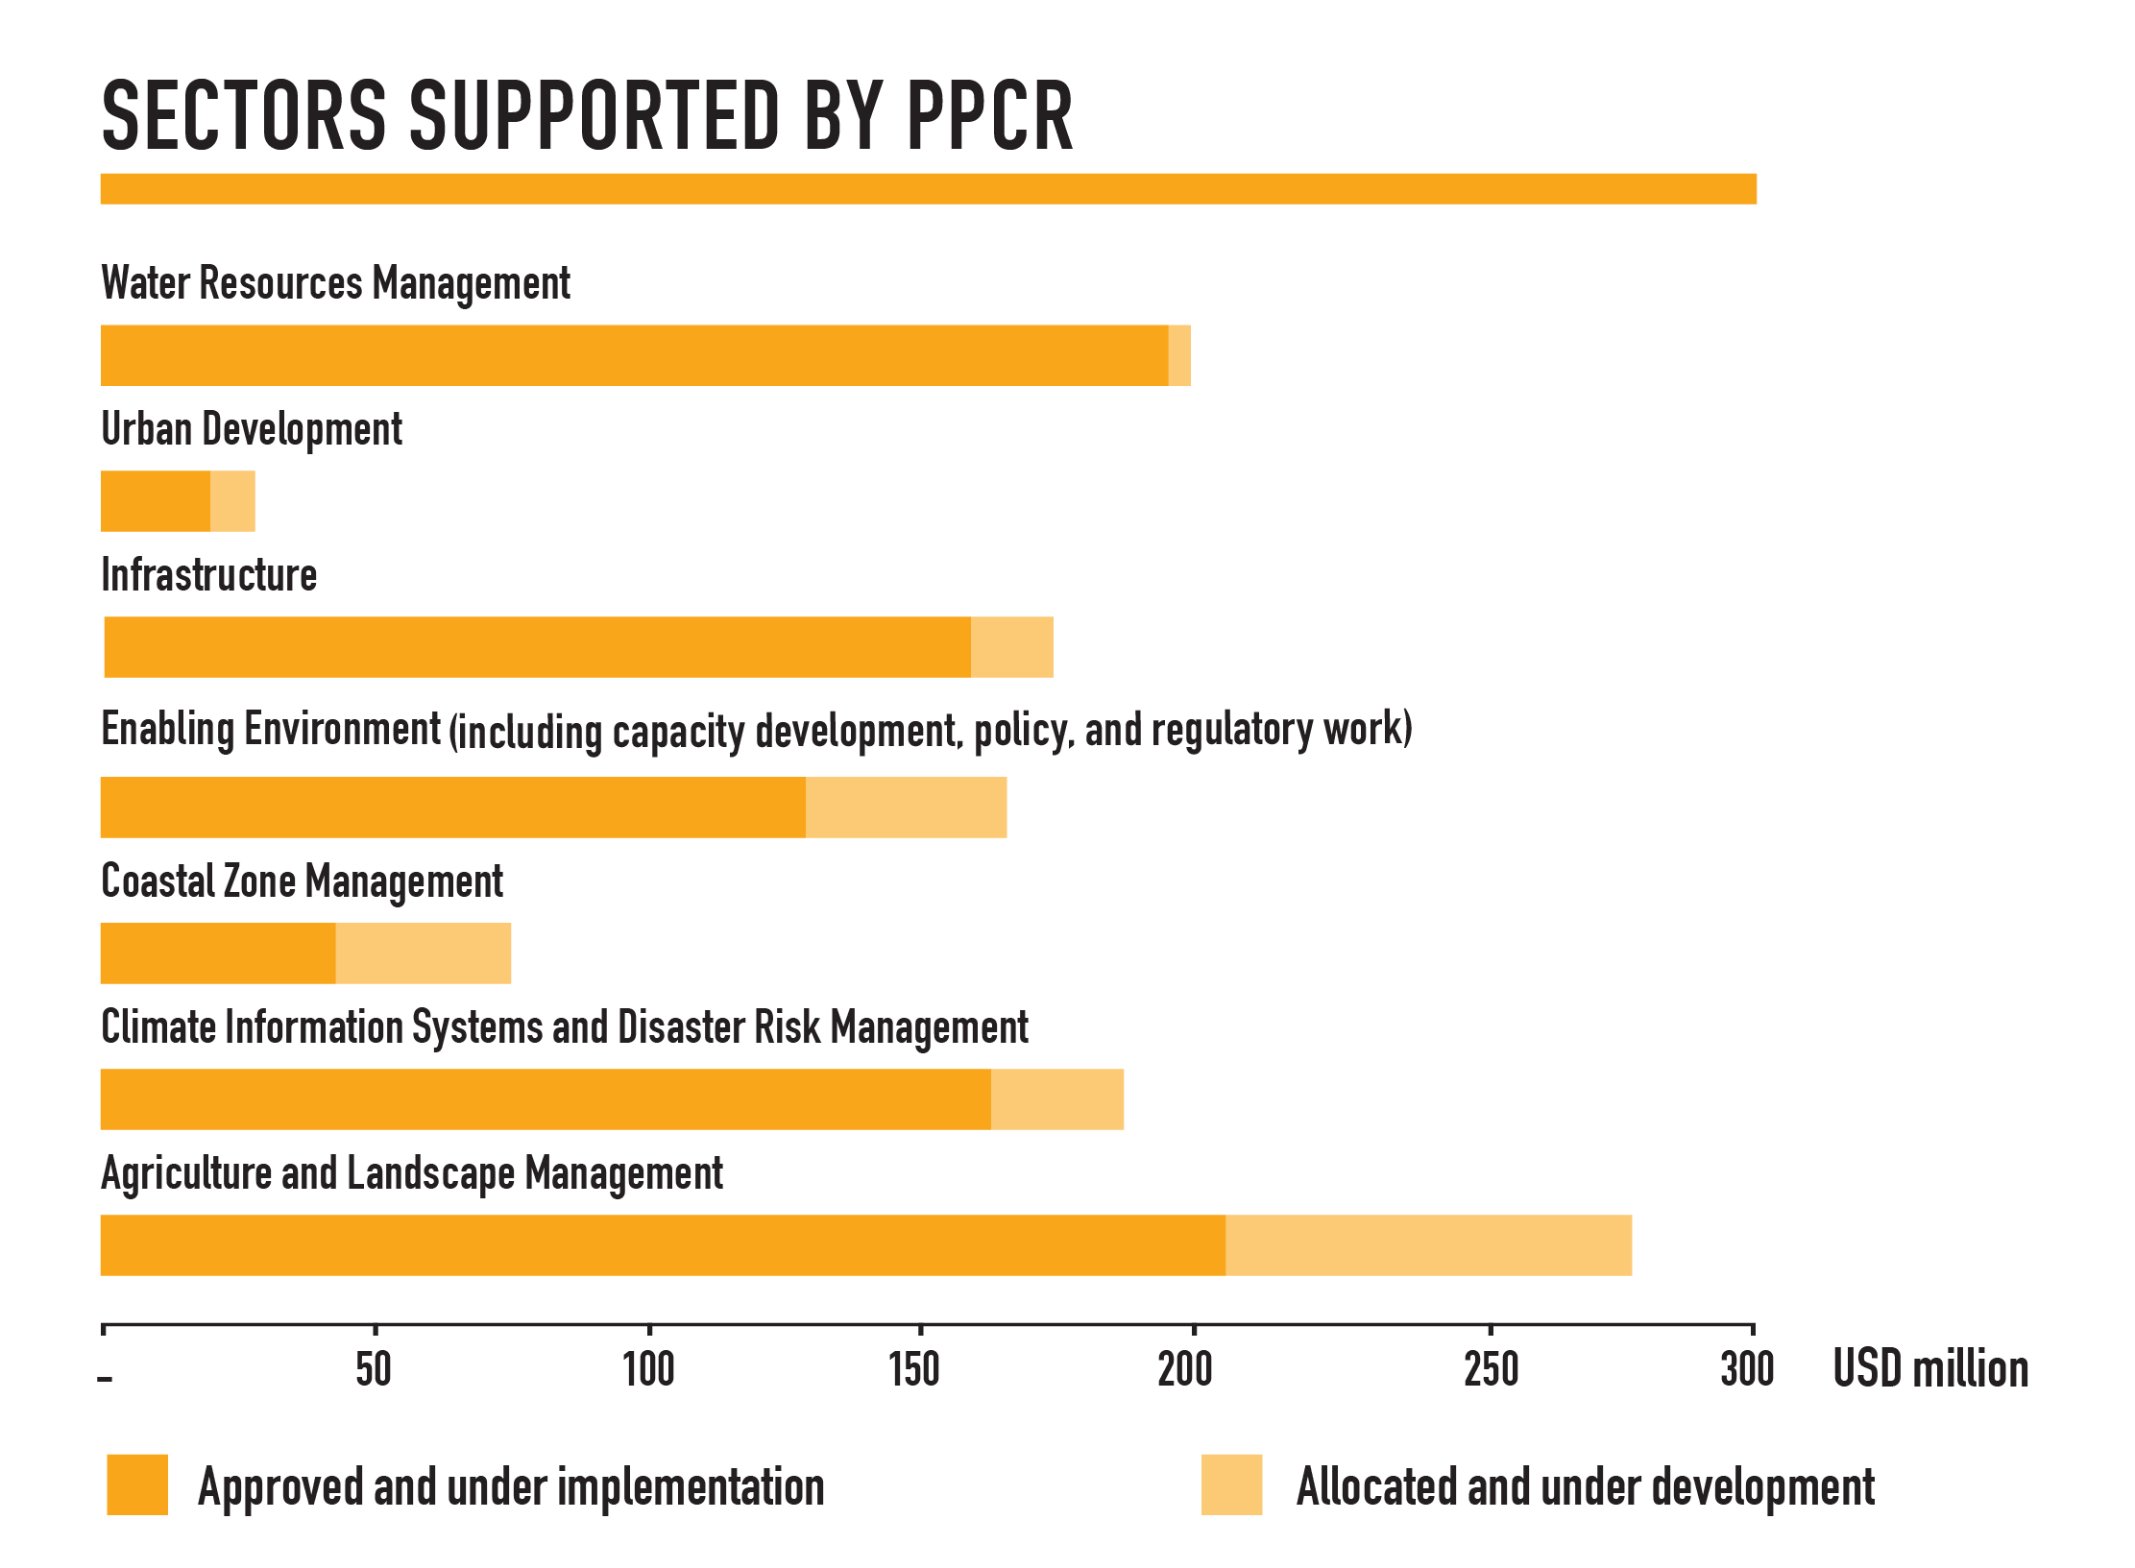
Breakdown of Sectors Supported by the PPCR
Notes:
Make sure it’s most updated
Major sectors that have been supported are these:

Slide 11
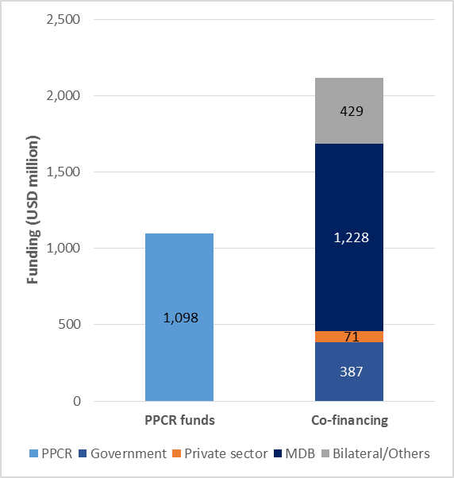
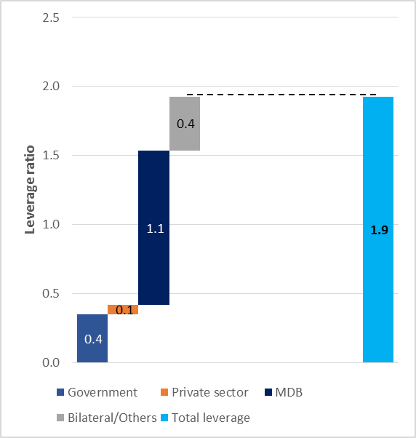
Co Financing and Leverage Ratio in the PPCR
Co Financing by Source
Leverage Ratio
Notes:
total co-financing figures in the PPCR disaggregated by source
For every 1 Dollar of PPCR investment approximately 1.9 $ is leveraged. Government Commitment to process is very important and is reflected in the 0.4 leveraging ratio.

Slide 12

Cross Cutting Issues Updates:
Gender
Portfolio continued to improve in terms of performance on all 3 gender indicators
  Gender ”quality at entry”: portfolio showed continued improvement relative to the baseline (better than SCF averages)
  For projects approved as of 2015, sector-specific gender analysis was undertaken in 88 percent of projects (SCF avg. 85 percent)
  Gender-disaggregated indicators at project level were present in 88 percent of projects (SCF avg. 71 percent)
  Three-quarters of projects approved had planned specific activities aimed at women (SCF avg. 77 percent)
Notes:
Gender Update: A full portfolio review was undertaken across all four CIF programs at investment plan and project level approved from January 1 to December 31, 2015, to identify program progress regarding gender “quality at entry.” PPCR project performance on all three gender indicators in this review continued to improve relative to the historical baseline, and also performed very well against SCF comparators.

Slide 13
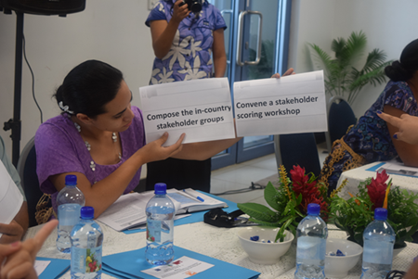
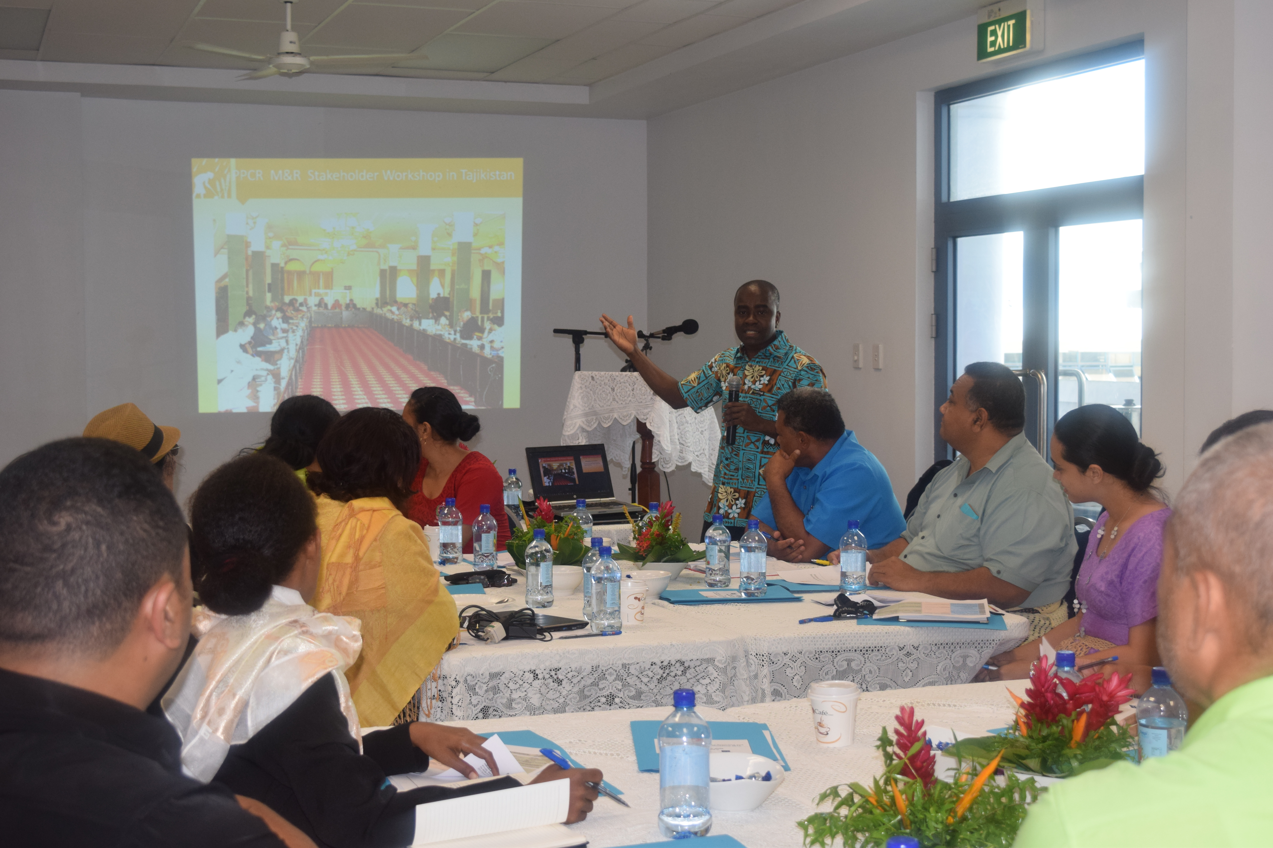
Cross Cutting Issues Update:
Monitoring and Reporting
Monitoring and reporting toolkit revised to reflect the Sub-Committee request in November 2015 for more gender-disaggregated data
Provide more guidance to pilot countries and MDBs on how to better report on confidential private sector project data
From November 21 to 28, 2015, the PPCR, in collaboration with ADB, held a two-day monitoring and evaluation training workshop organized by the Tajikistan PPCR Secretariat.
Notes:
Monitoring and Reporting Update: In the spirit of the CIF's learning-by-doing approach, the PPCR monitoring and reporting toolkit was slightly revised to reflect a request made by the PPCR Sub-Committee (November 2015 meeting) for more gender-disaggregated data and also to provide more guidance to pilot countries and MDBs on how to better report on confidential and sensitive private sector data and information. The revised toolkit will guide PPCR countries and MDBs during the FY16 results reporting round that will start in the second quarter of FY16.
From November 21 to 28, 2015, the CIF Administration Unit, in collaboration with ADB, participated in two-day monitoring and evaluation training workshops organized by the Tajikistan PPCR Secretariat.

Slide 14
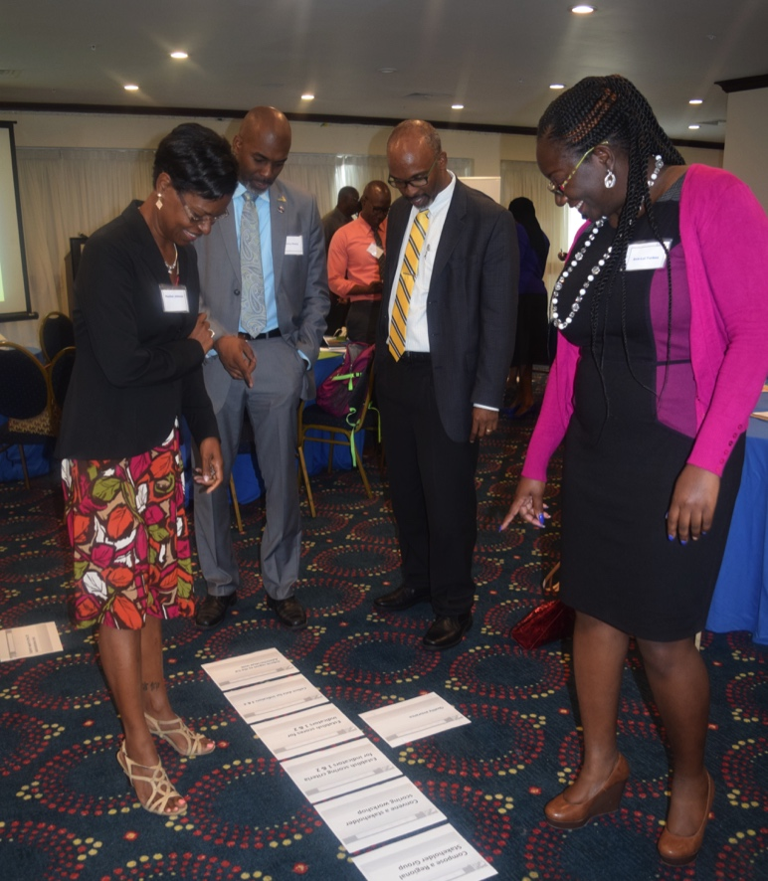
Caribbean Regional Workshop
Monitoring and Reporting/S-S Exchange
Caribbean Regional Workshop
PPCR, in collaboration with the IDB, held a two day Caribbean Regional M&R workshop, that facilitated S-S exchange and sharing of information between 5 Regional PPCR Countries and 12 Regional Organizations.

Slide 15
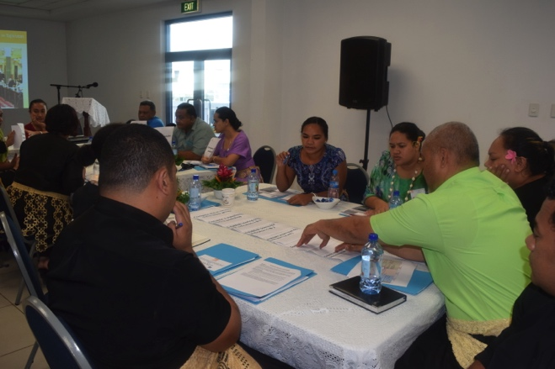
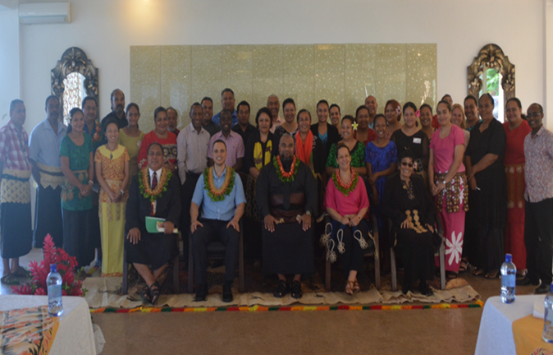
Pacific Regional Workshop
Monitoring and Reporting
Pacific Regional Workshop
June 1 – 4. 2016
PPCR, in collaboration with the ADB held a 4 day Workshop (2 days of M&R and 1 day Stakeholder Consultation and 1 day of site visits to PPCR sites) in the Kingdom of Tonga
Neighbouring countries of Samoa and Papua New Guinea also participated as a means of facilitating South-South exchanges. Both regions have requested Regional exchanges and dialogue has started with the ADB and IDB.

Slide 16
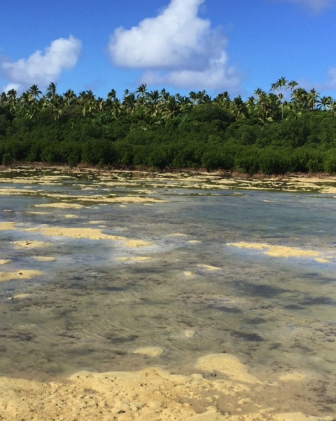
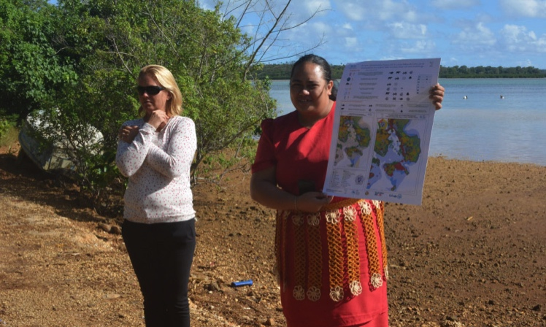
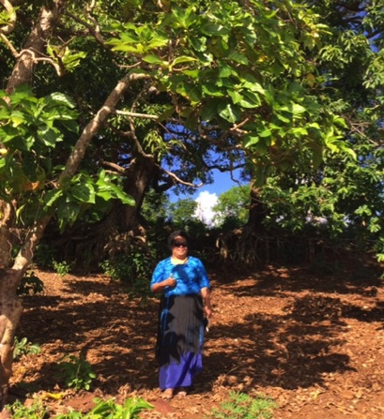
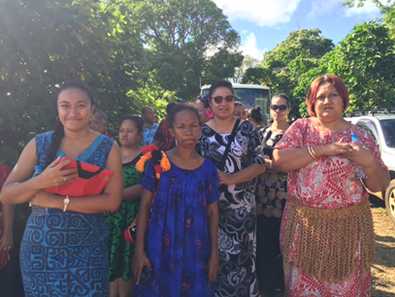

Pacific Regional Workshop:
Stakeholder Consultation, Knowledge Exchange & S-S Learning

Slide 17
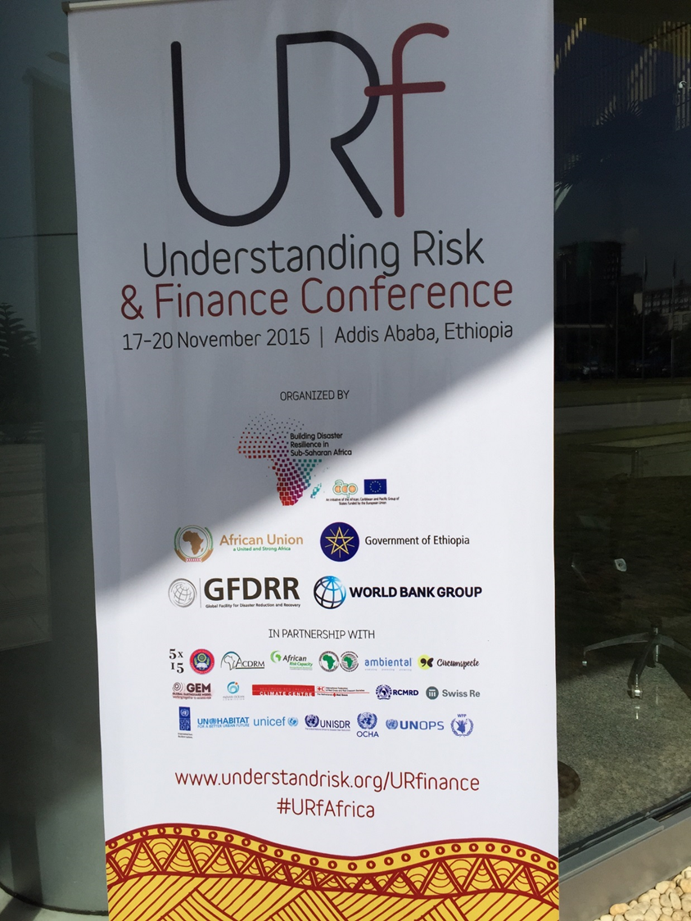
PPCR Workshops and Conferences
Ethiopia Finance Disaster Risk and Resilience Conference (Nov 2015) The CIF PPCR participated in the Conference with special inputs on PPCR Disaster related projects such as the Caribbean DVRM project and PPCR Projects in Africa.
2) Workshop held by the Directorate-General for Climate Action of the European Commission on insurance and climate related natural disasters. (Feb 16)
The CIF PPCR participated in a workshop focused on how insurance modalities are applied throughout the EU, with a specific aim to exchange experiences in applying various insurance insturments for prevention of damages and risk reduction. The PPCR’s participation focused on sharing lessons learned from our evidence based work on the role of insurance-based mechanisms in promoting climate resilience.

Slide 18
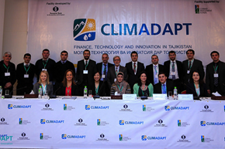
CLIMADPAT Launch
CLIMADPAT Launch
November 2016
CIF PPCR provided 15M, through the EBRD to 3 Banks in Tajikistan.
This fund targets climate smart agriculture (drip irrigation), Households (water) and soil conservation (equipment) at extremely low interest rates.

Slide 19
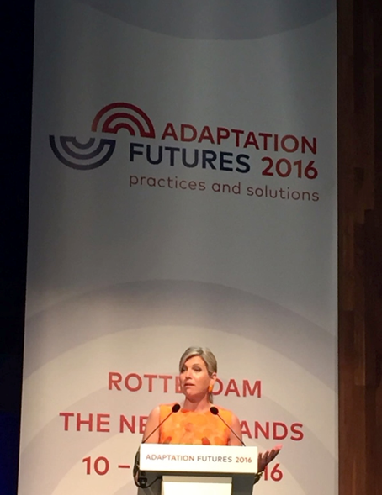
Adaptation Futures Meeting
Adaptation Futures Meeting
May 2016
A CIF PPCR Conference Session was held, where three PPCR pilot countries (Tajikistan, St. Lucia and Zambia) came together to share lessons on mainstreaming resilience into development planning and investment.
Notes:
Adaptation Futures Meeting: The CIF, in partnership with the World Bank Group, organized an event to share lessons on the PPCR programmatic approach in the context of climate resilience, on the sidelines of Adaptation Futures 2016, the 4th International Climate Change Adaptation Conference in Rotterdam, the Netherlands. The panel event took place on May 10, 2016 and brought together three PPCR pilot countries (Tajikistan, St. Lucia and Zambia) to share lessons on mainstreaming resilience into development planning and investment. The meeting was praised afterwards for bringing concrete evidence of how the programmatic approach can deliver transformational change.

Slide 20
Strategic Issues: Resource Availability in the PPCR
Expected Deficit for existing projects: USD 17.57 million.
Notes:
As of December 30, 2015, the PPCR’s USD 152.53 million funding requirements exceed the USD 134.96 million resources available to support PPCR programming by USD 17.57 million. These funding requirements include a pipeline of projects from endorsed SPCRs and PSSA that will be submitted for PPCR Sub-Committee approval.
For the 10 new pilot countries, USD 1.5 million has been made available for each country to take a leadership role in working with the MDBs to develop its full strategic program for climate resilience (SPCRs).
The uncertainty regarding funding for SPCR implementation remains a concern for new pilot countries.

Slide 21

Thank You!
www.climateinvestmentfunds.org
@CIF_Action
https://www.youtube.com/user/CIFaction
https://www.flickr.com/photos/cifaction/sets
Email: Rallen2@worldbank.org

