Slide 1
Report from Joint Meeting on Strategic Directions of the CIF
^{DATE June 17, 2016}
^{PLACE Oaxaca,} ^{Mexico}
VENUE SREP Sub-Committee Meeting

Slide 2
Outcomes from the Joint Meeting
Excerpts from the decision of the joint meeting on the strategic directions for the CIF:
Notes that the analysis took into account future opportunities and explored roles each CIF program could play based on its comparative advantage and value added.
Notes the need to support the continuity of climate finance flows at scale in the near term through a diverse set of finance options
Recognizes the important role of the MDBs delivering climate finance
Highlights the importance of disbursing current CIF funds effectively
Agrees to continue monitoring the developments in the international climate finance architecture to inform the discussion on the sunset clause in Dec 2018 at the earliest, and take decision on this issue in June 2019, in particular as to if and when the Trustee should stop receiving new contributions for the CTF and/or the SCF.

Slide 3
Outcomes from the Joint Meeting
Excerpts from the decision of the joint meeting on the strategic directions for the CIF:
Agrees to enhance cooperation between CIF and other entities, particularly GCF through
Improved coordination at country level led by CIF Focal Points and GCF NDAs, including cooperation with MDBs as requested
Enhanced efforts by all CIF stakeholders to share lessons learned, including through CIF’s evaluation and learning special initiative
Explore joint training and learning for CIF and other multilateral climate finance mechanisms
Invites SCF Sub-Committees to consider the analysis presented the Strategic Directions paper on the specific context, lessons learned, and continued value proposition of these three programs (FIP, SREP and PPCR).

Slide 4
Lessons Learned from SREP
SREP funding has been instrumental to de-risk and lower capital costs of investments
SREP has encouraged MDBs and countries to engage in energy access dialogues
Small allocations for large countries and for multiple MDB engagement/Insufficient grants for countries and projects in need
Lack of predictability of new resources
Lack of resources from the MDBs
More flexibility needed for MDBs to capture private sector market opportunities

Slide 5
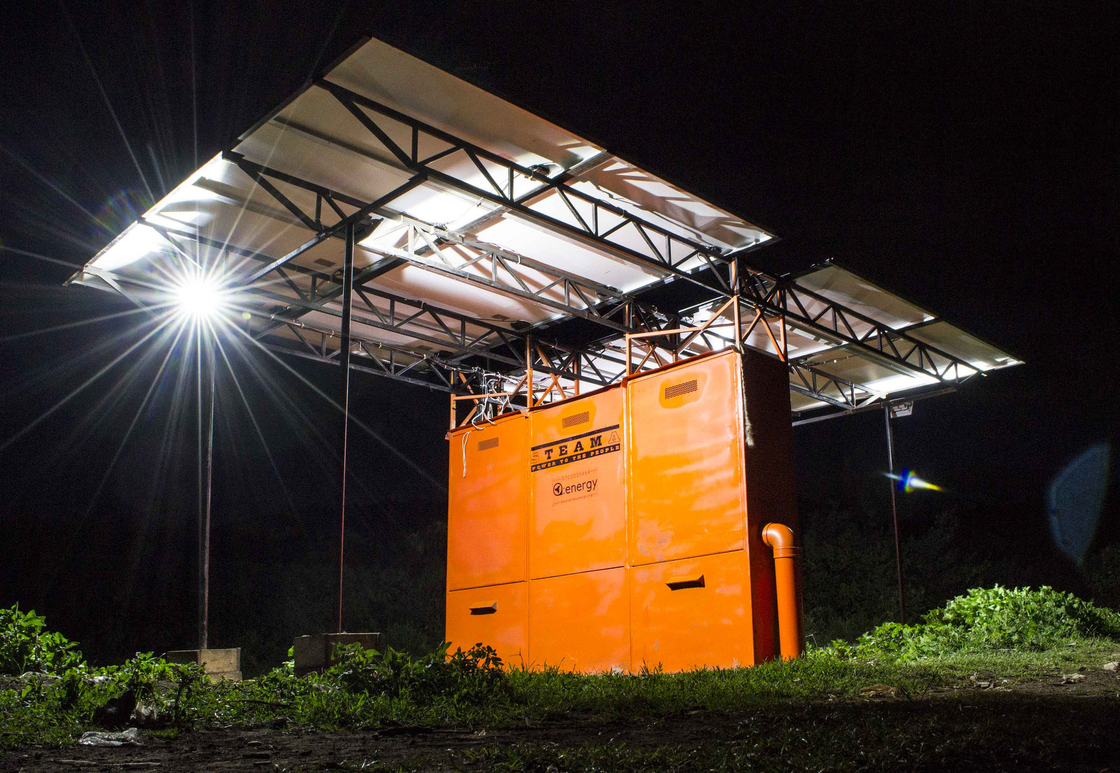
SREP: Value proposition and future scenarios
SREP continued value proposition:
Bring energy access into strategic dialogues between countries/MDBs
Fill concessional finance gap
Without new funding: Uncertainty for the nine countries that have yet to submit IPs (all have prioritized RE in INDCs)
With new funding:
Extend implementation funding for new countries
Launch enhanced private sector window focused on energy access with more flexibility

Slide 6
Features of Proposed New Program: Dedicated Private Sector Program for Energy Access
Allow more flexibility to capture market opportunities
Participation extended to all countries meeting SREP eligibility
Maximize synergies with other initiatives
Focus on decentralized renewable energy solutions
Technologies: solar, wind, biomass
Applications: lighting, cooking, schools, clinics, communities, businesses
Allow local currency lending

Slide 7
Potential Areas of Intervention
Scale-up of off-grid solar home systems from basic lighting to appliances
Installation of rooftop solar for commercial, industrial, and residential customers
Support of distributed energy service companies to remove financing barriers
Support of innovative business models and technologies deliver power to local communities through mini-grids
Production and distribution of clean, efficient biomass cookstoves
Support of critical enabling infrastructure
Targeted TA and AS to create and strengthen the enabling environments for the private sector to participate in the renewable markets

Slide 8
Mafalda Duarte
Mduarte@worldbank.org
(202) 473 - 4678
www.climateinvestmentfunds.org
@CIF_Action https://www.youtube.com/user/CIFaction https://www.flickr.com/photos/cifaction/sets

