Slide 1
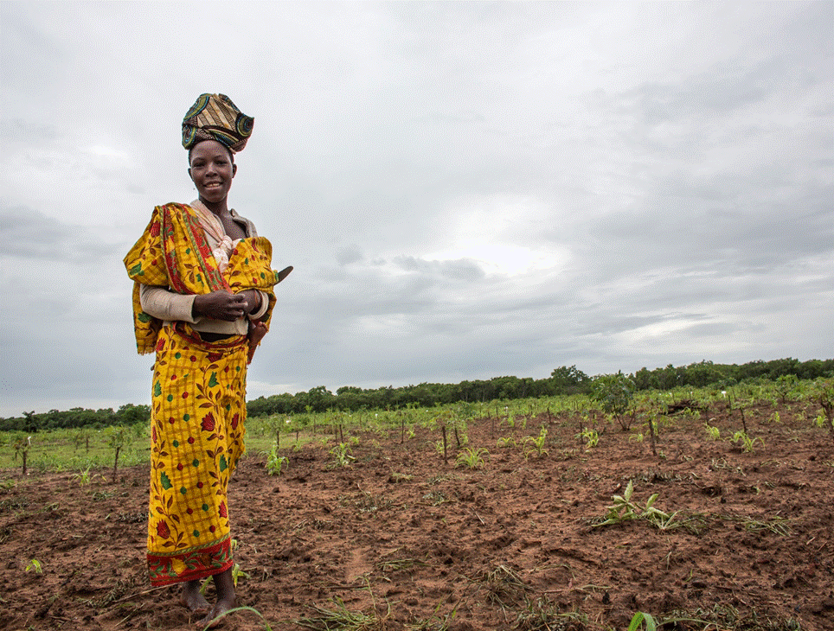
MOZAMBIQUE’S FOREST INVESTMENT PLAN
MINISTRY OF LAND, ENVIRONMENT AND RURAL DEVELOPMENT
International Funds Management Unit
FIP Sub-Committee Meeting
Oaxaca, Mexico | June 2016

Slide 2
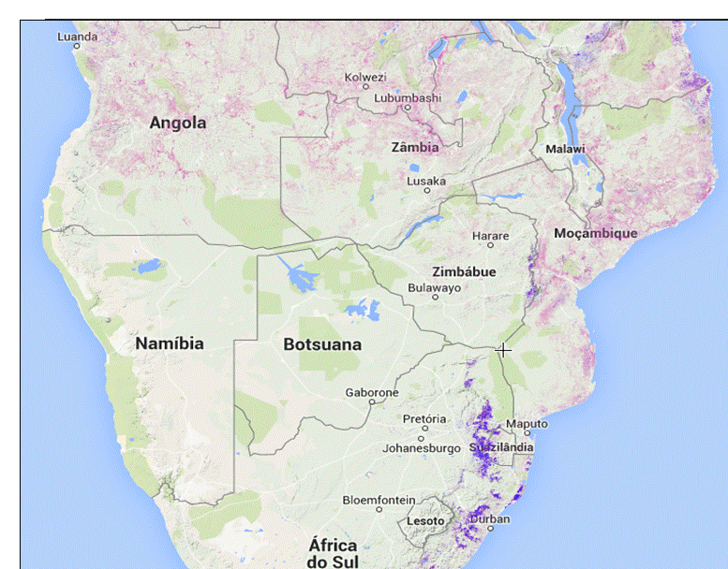
Mozambique: Development & Climate Context
High exposure and high vulnerability to climate change impacts
54% below the poverty line
70% living in rural areas
Population
HDI
178 out of 187 countries
8.5% GDP growth rate (2014)
5th highest rate in Africa
Agriculture: major sector of economy (32% of GDP) = pressure on forests
Economy
Emerging from political conflict
1st Mo Ibraim Prize for Good Governance
Attraction of large public/private inv.
Politics
Map: Global Forest Watch (2015)

Slide 3
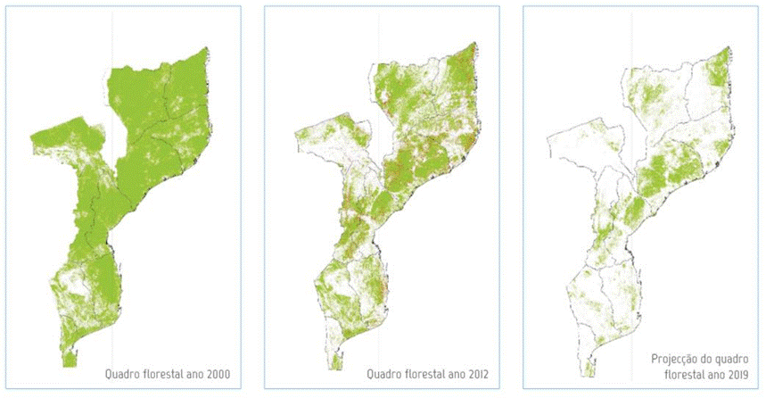
0.58% deforestation rate | 220,000ha/year 50% of national GHG emissions
Forests in Mozambique
51% forest cover | 29Mha productive forests | 13.3Mha forest conservation areas | Miombo main forest ecosystem |
Forest Cover Loss
2000
2012
2019

Slide 4
REDD+ STRATEGY: MAIN DRIVERS OF DEFORESTATION
Slash & Burn
Agriculture
Urban Expansion
Exploitation of Forest Products
Charcoal Fuel
Commercial
Agriculture
REDD+ STRATEGY: SIX PILLARS OF INTERVENTION
TO REDUCE DEFORESTATION BY 40% BY 2030
Sustainable Agriculture
Sustainable Forest Management
Sustainable Energy
Forest Restoration
Conservation Areas
Cross Cutting
FIP MITIGATION POTENTIAL: AVOIDING 15 M TCO2 (2016-2025)

Slide 5
Integration with Government’s Sustainable Rural Development Goals
STRONG NATIONAL POLITICAL COMMITMENT
New Ministry of Land, Environment and Rural Development (MITADER)
National Program for Sustainable Development
Flagship program Projecto Floresta em Pé to transform forest sector, and forest sector reform
INDC presented to the UNFCCC in 2015
National emissions reductions targets in the forest sector by 30% by 2021 and 40% by 2030
National REDD+ Strategy in 2016

Slide 6
Institutional Arrangements for REDD+
COUNCIL OF MINISTERS
Prime Minister
(Chair)
DNPC
DINAB
DNOT
DNDR
DINAF
MITADER
(Vice Chair)
MFE
CONDES (Council for Sustainable Development)
MMAIP
UGFI
(International Funds
Management Unit)
MINAG
MAEFP
Inter-Institutional Collaboration (FIP Steering Committee, CONDES)
MIREME
Local Stakeholder Collaboration
MIC
MOPHRH
3 Individuals
3 Academia
Service Providers (NGOs, Private Sector)
3 Civil Society / Private Sector

Slide 7
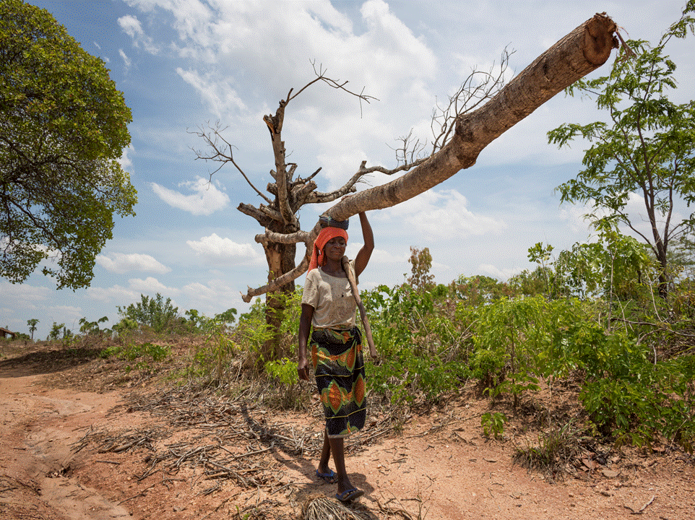
EXPECTED CO-BENEFITS FROM
FIP INVESTMENTS
Improved governance and institutional capacity
Resilience to climate change impacts
Sustainable forest and land management
Rehabilitation of degraded lands and improved ecosystems through reforestation
Income diversification and employment generation among communities
Decreased pressure on forests through sustainable biomass
Community engagement in improved agricultural and land management
Transformational value added
Notes:
Climate c

Slide 8
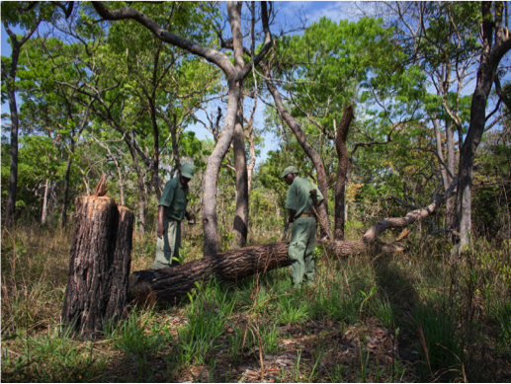
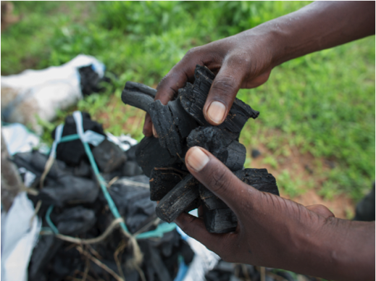
FIP Strategic Direction
National Level
Landscape Level
Policy and legal reform, governance and strengthening of capacity that will create the enabling conditions for change
Transform economic activities and opportunities across sectors to improve forest and land management practices and contribute to rural livelihood improvements

Slide 9
Mozambique’s Forest Investment Plan
Project One
Project Two
Mozambique Forest Investment Project (MozFIP)
Emissions Reductions in the Forest Sector through Planted Forests with Major Investors (IFC)
Enabling and Governance Reforms
Legal and institutional reform
Strengthening Governance
Private sector enabling conditions
Communication, consultations, outreach
Piloting models for community engagement
Training and technical assistance to communities
Promotion of conservation agriculture and key sustainable forest and agriculture-based supply chains
Spatial planning and participatory micro-zoning
Sustainable Agriculture & Livelihoods
Conservation agriculture
Participatory micro-zoning
DEEPENING OF INITIAL ACTIVITIES, NEW THEMATIC AREAS
Sustainable Biomass Energy
Reduced biomass energy use
Improved biomass energy production
Promotion of alternatives
Promotion of alternative species for biomass energy
New Multi-Use Forests
Sustainable forest management
Supporting community-company engagement
Restoration
Community engagement in
outgrower schemes
EXPANSION TO MORE LANDSCAPES
Notes:
EDITED

Slide 10
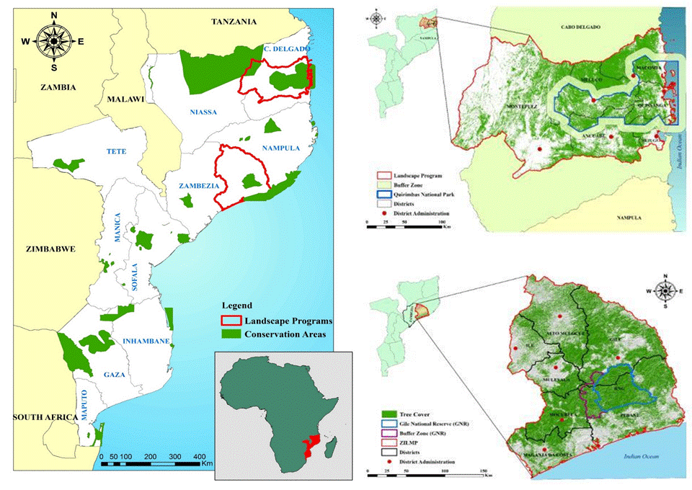
Landscape-Level FIP Interventions
CABO DELGADO
ZAMBEZIA

Slide 11
FIP Package and Financing Plan
Co-Financing Leveraged: GoM own funds, Multi-Donor Trust Fund, Private Sector buy in, DGM for Local Communities (~$18.6M)
Parallel Financing: MozBio, Agric & NRM Landscapes Project (~$134.6M)

Slide 12
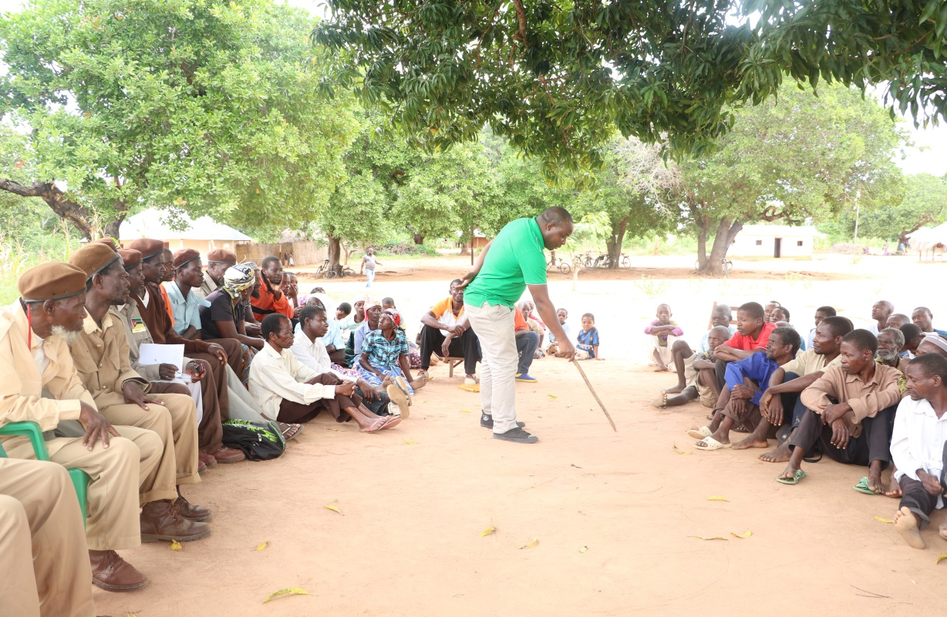
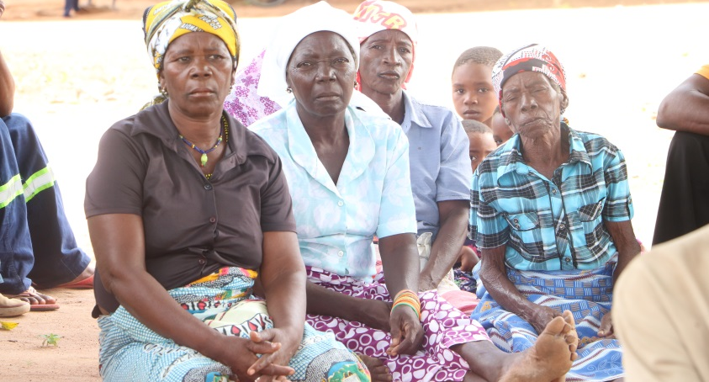
Stakeholder Participation and Consultations
Ongoing public consultations at national, provincial and district levels since 2010
Active multi-stakeholder provincial forums involving local governments, private sector, academia, civil society, local communities
Online questionnaire; comments and all consultations posted online
www.redd.org.mz

Slide 13
Inclusive Process and Partnerships
Government
Ministry of Land, Environment and Rural Development (MITADER)
Private Sector
Portucel Mozambique
Other
Ministry of Agriculture
Provincial Government of Zambézia and Cabo Delgado
Forest Concession Holder
Reforestation Companies
Tourism concessionaires
Ministry of Energy
Timber Association
World Bank
AfDB
IFC
PNUD
FAO
WWF
IUCN
IIED
And others
Notes:
- Incluir logo dos demais parceiros?
- Checar nome da Associação de Madeireiros de Zambezia (Zambezia Timber Association)

Slide 14
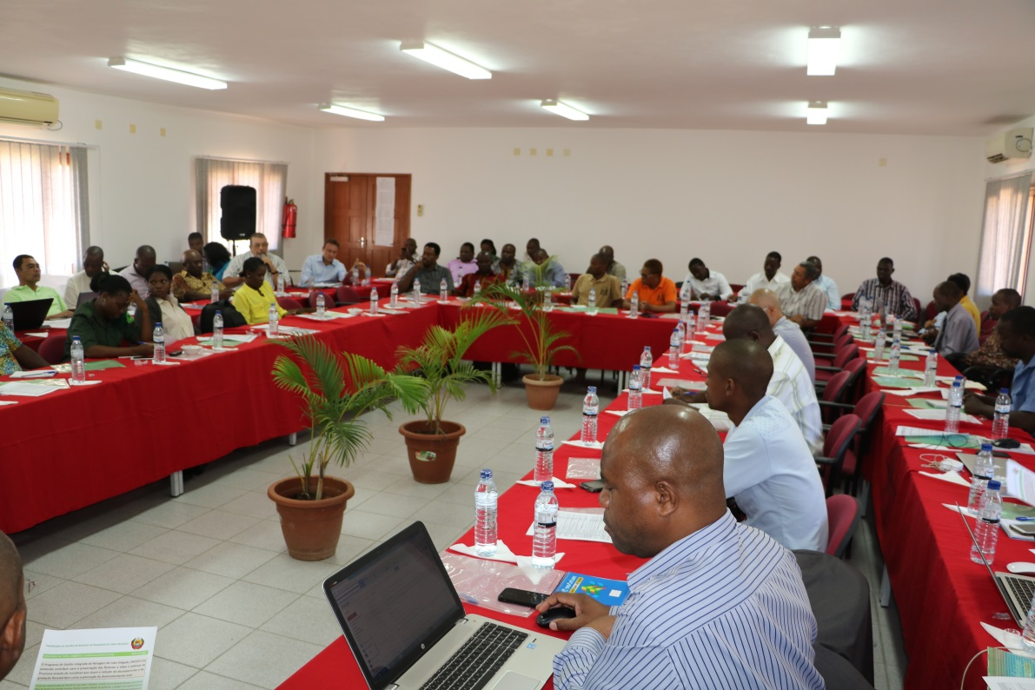
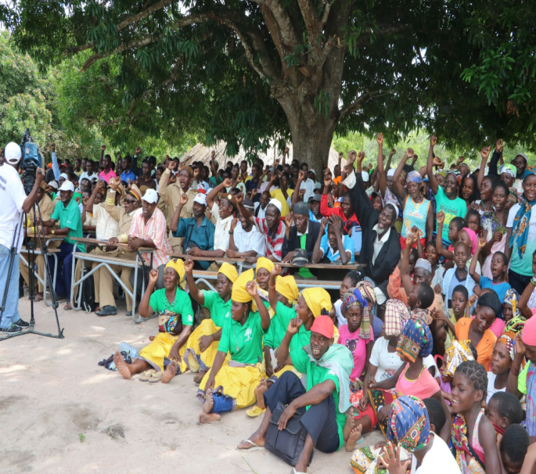
Mozambique’s Dedicated Grant Mechanism for Local Communities
DGM will promote synergies with broader FIP and REDD+ activities
DGM will overlap with FIP investment areas and have a national reach
Objective is to align DGM timeline as much as possible with the FIP
Current status: Dynamic process with active interim NSC; DGM projects already pre-identified

Slide 15
WHERE DO WE GO FROM HERE? Govt Plan for Scale Up, Replication and Leveraging Finance
FIP framework leveraged to attract additional funding for deepening and expanding FIP activities
Transformational impact achieved for sustainable rural development in the country
Private sector stimulation inspires replication
Landscape-level solutions demonstrated and applied nation-wide
National-level reforms impact entire country
Notes:
National Level Reforms = Enabling and Governance Reforms
Sectoral Solutions = Viable Conservation Agriculture and Biomass Solutions
Private Sector Stimulation – Planted Forests, Forest Certification, Processing etc.

Slide 16
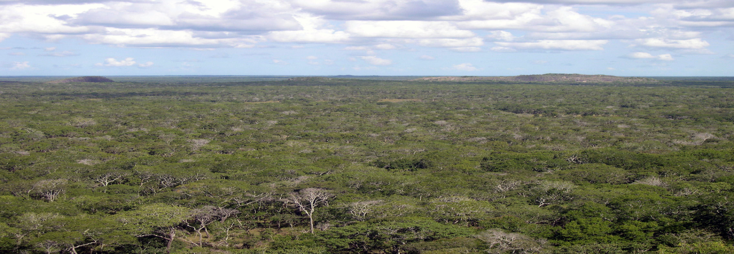
Gracias. Thank you. Muito obrigado!

