Slide 1

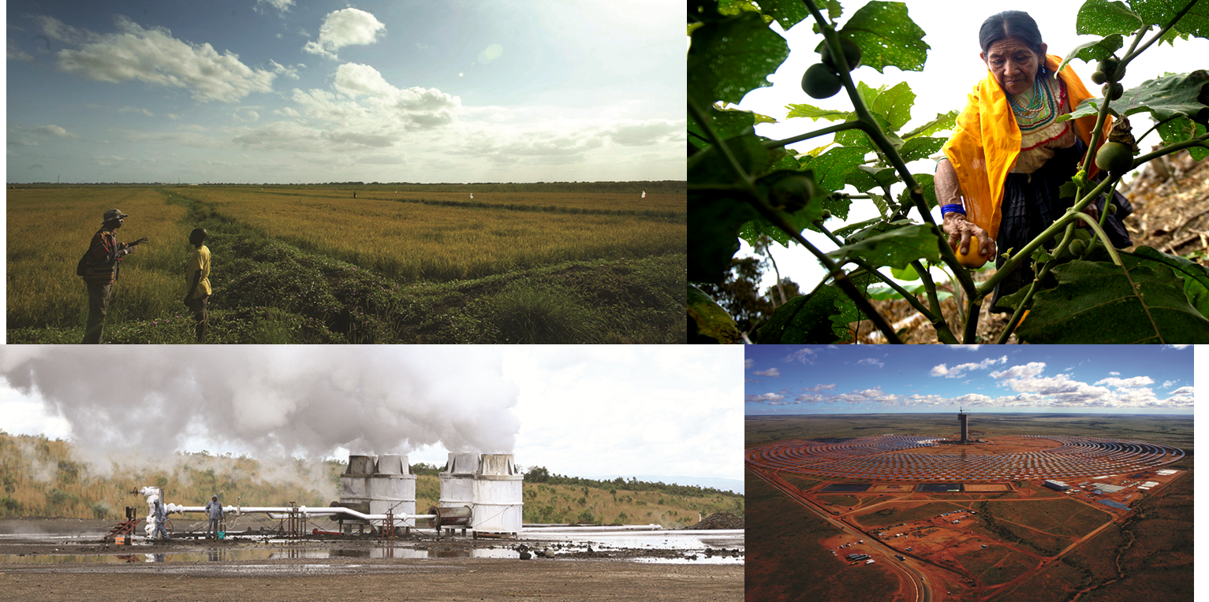
CTF Semi-Annual Operational Report
^{DATE June 16, 2016}
^{PLACE Oaxaca,} ^{Mexico}
^{VENUE CTF} ^{Trust Fund Committee Meeting}

Slide 2
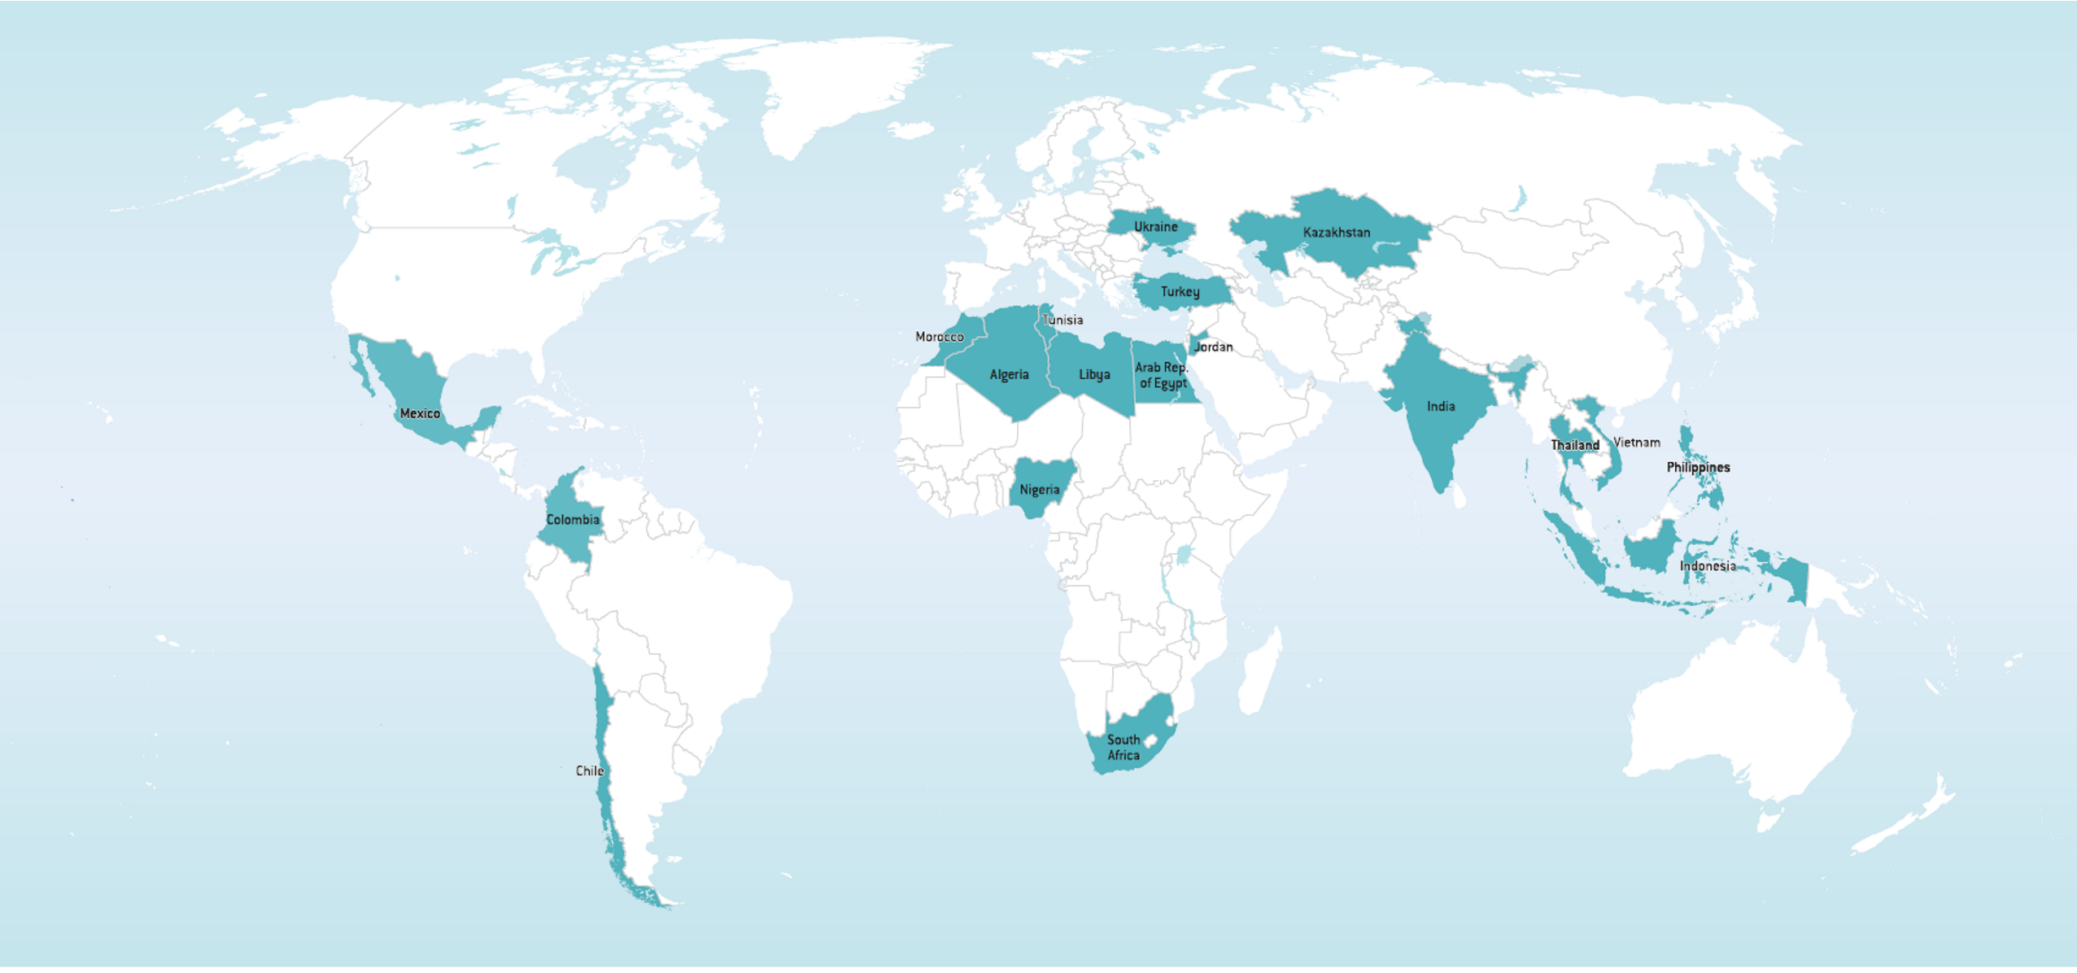
Overview of the CTF
 | Indicative Allocation |  |  | Approved |  | Disbursement
 | TOTAL | IP | DPSP | TFC | MDB
CTF Funding (in $M) | 6,093.5 | 5,585.0 | 508.5 | 4,538.4 | 3,543.2 | 1,582.2
Number of projects | 123 | 105 | 18 | 92 | 76 | 60

Slide 3
Resource Availability
Addendum to update resource availability schedule and project approvals as of May 31
Available resources (current + reserves + expected):
477.9+154.9+73.8 = $706.6 million
Projected investment income – admin cost = $9.9 million
Net available resources: 706.6+9.9 = $716.5 million
Remaining pipeline: $840.9 million
Over-programming: $124.4 million

Slide 4
Strategic Issues
  CIF Enterprise Risk Management (ERM) Framework
  ERM framework was established to identify, assess, and report on the CIF’s risk exposures relative to corresponding tolerances.
  The CTF Risk Dashboard was launched in January 2016 as an online platform for reporting CTF-related risk assessments.
  Pipeline Management and Cancellation Policy
    Document circulated for decision by mail by July 1, 2016
    Key feature: potential release of funding
  New Financing Modalities
    To explore detailed modalities to strengthen the current business model of the CTF in mobilizing additional capital from public and private sources and deploy its resources efficiently and effectively
    Options: CTF Green Markets, Risk Mitigation Facility, and/or a combination

Slide 5
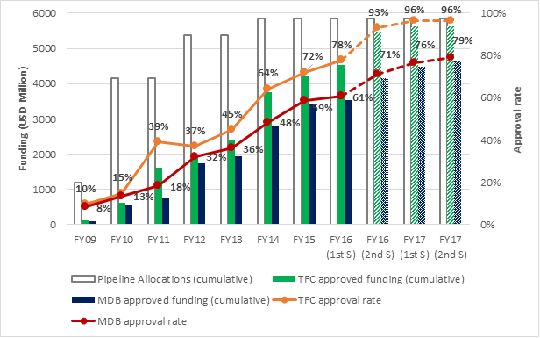
Funding Approval
About 75% of the indicative allocations under IPs and DPSP have been approved.
During July – Dec 15:
  12 projects ($330 million) were approved by TFC, of which 51% were DPSP
  13 projects ($196 million) were approved by MDBs, of which 47% were DPSP

Slide 6
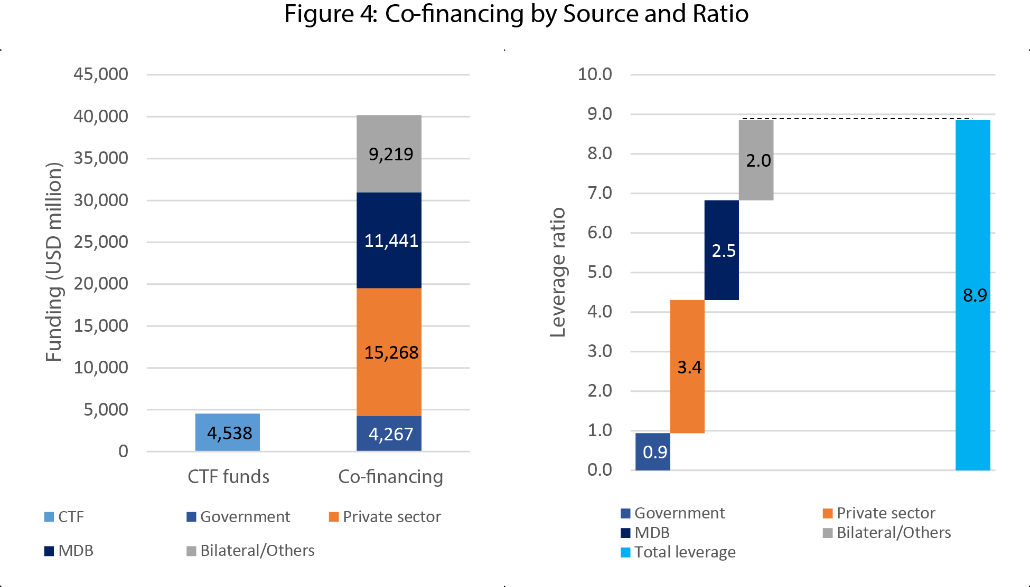
Co-financing by Source and Ratio

Slide 7
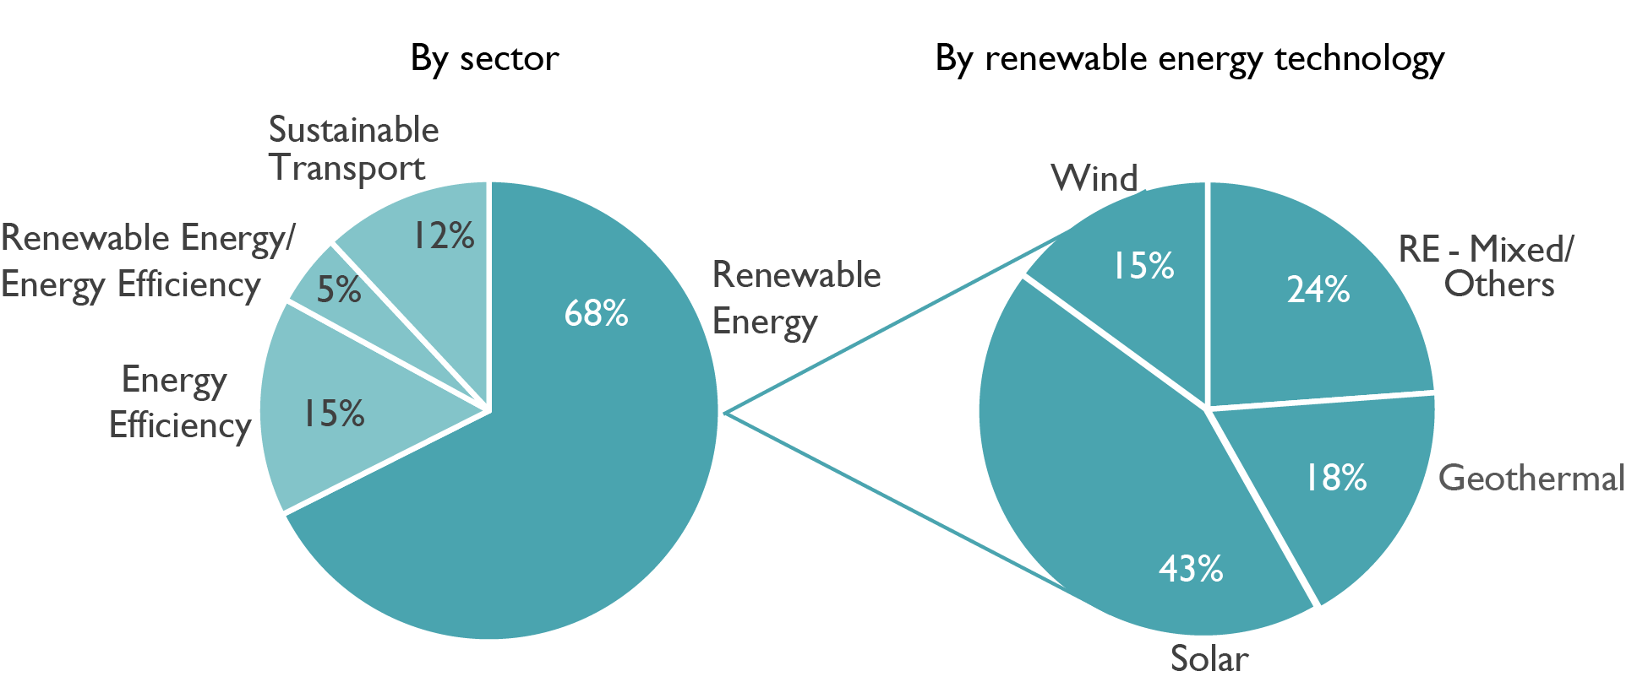
Portfolio Analysis

Slide 8
Disbursements by Fiscal Year

Slide 9




Zhihong Zhang, Ph.D.
Senior Program Coordinator
CTF and SREP zzhang2@worldbank.org
(202) 473-9852
www.climateinvestmentfunds.org
@CIF_Action
https://www.youtube.com/user/CIFaction
https://www.flickr.com/photos/cifaction/sets

